Slide 1


Welcome
www.steyningprimary.org.uk
Have a look at our website for information on all aspects of school life, including key dates in the school calendar.

Slide 2
Welcome Parents and Carers
Aims:
To give you an insight into what happens in September for the new EYFS children and parents / carers of Steyning CofE Primary school
To point parents / carers in the direction of support materials
To provide an opportunity for parents / carers to get to know the Early Years teaching staff

Slide 3

Key Features of the EYFS
To strengthen partnerships between parents / carers and professionals
To highlight what children learn
To highlight how children learn

Slide 4

Parent Partnership
Home visits
Evidence Me
Weekly Overview Sheet
The EYFS Website page
Half termly ‘Next Steps’ sheets
Come in and support us

Slide 5

Downloadable Parent Information Booklet
https://foundationyears.org.uk/what-to-expect-when/
The purpose of this booklet is to help you as a parent/carer find out more about how your child is learning and developing during their first five years.
It has been written to help you know what to expect during these vitally important years by focusing on the seven areas of learning and development which are covered in the EYFS.

Slide 6

Tips for Starting School
Handout in your child’s pack

Slide 7





What Can my Child do to Prepare Themselves?
On their own, practise changing in and out of their PE kit from their uniform and back again, including being able to independently turn clothes the right way round
Cut their own food up using a knife and fork
Hold a plate of food and walk it a distance of 10 metres without spilling and placing it on the table
Make a ‘This is Me’ book about themselves containing photographs of people and items that are special to them so they can share throughout the first year of school (scrap book in book bag)
Hold things like a paintbrush / tweezers / scissors / pen in a preferred hand and use them safely and with control

Slide 8


Top Tips for You
At the gate, try to say goodbye quickly and encourage your child to come to line up independently. Stay positive and upbeat. This usually makes the transition so much easier for the children
Encourage and keep to a consistent bedtime routine and bed time. This will help prepare your child for sleep by helping them relax and wind down and be refreshed and ready for their days at school
Talk to your child about their day. Try to use open questions and use the EYFS Weekly Overview as a starting point
Attend as many school run workshops as you can. There are for you to understand how your child learns in different areas and support them in their development
Talk to us about any worries or concerns, or simply if you have any questions! We would rather be able to help you as soon as we can

Slide 9


What Does My Child Need in School?
Items to be kept at school:
PE kit in house colour including trainers or plimsolls
Put spare clothes including underwear in your child’s bag, along with an empty carrier bag
Wellies and rain mac
Items to be brought in daily:
Book bag (available to purchase at First4Uniform)
Water bottle
Snack
Donations if you wish to:
Wet wipes
Tissues (boxed)
Clean socks / underwear
PLEASE ENSURE EVERYTHING IS CLEARLY LABELLED!

Slide 10
Welcome to Our School Library
Children borrow books regularly during their time at school. They have regular sessions with our school librarian
During these session they share stories, learn how to use the library and learn how to use books to support their learning in class
Please encourage your children to:
  Share their library book with you at home
  Look after their library book
  Return their library books as soon as they have finished with them

Slide 11

School Meals
We are excited to announce that we have a new catering company from September: FEED (Feeding Excellence Every Day) by ISS.
We are hosting a FEED roadshow on Monday 13th July at 3.15pm in the front playground and you are all welcome to come along and try out their food.
We will be in contact once we have details about how to set up your account via
their Parent Portal.

Slide 12
Office Forms
Enrolment Forms
If you haven’t already, please complete the online Enrolment form that was sent on 3rd June. If you need this to be sent again then please email the school office.
Medical Forms
If your child has any medical conditions i.e. asthma, ongoing health conditions then please can you complete the relevant medical forms. If you require these then please collect at the end of the session or email the school office.

Slide 13

School Communication
My Child At School (MCAS)
Please download this app.
You will receive your invitation code when your child starts school.
Book parents’ evenings / receive reports / attendance information

Slide 14

Transition Sessions
Your child is invited to attend two sessions to support their transition to school.
The first one will be a morning session, and the second one will be an afternoon:
Wednesday 1st July
09.15-10.15 OR 10:30-11:30
Friday 10th July
13:15-14:15 OR 14:15-15:15
Your child’s offered sessions are specified in their information pack.

Slide 15

What Does the First Week Look Like?
Tuesday 1st September
SCHOOL CLOSED for INSET days
Wednesday 2nd and Thursday 3rd
Home visits – please sign up for a slot this evening
Friday 4th September and Monday 7th September
Half Day Sessions – your child will either be here for the AM session (09:00-11:30) or PM session (12:30-15:00). You will get one morning and one afternoon session. Your child’s offered sessions are specified in their information packs.
Tuesday 8th September onwards
Full time school day with lunch (part time if desired / agreed)

Slide 16

Welcome to the FSPS!

Slide 17

We Need You!

Slide 18
What the FSPS Do:
Wellie racks outside classrooms
EYFS outdoor play area
Laptops
iPads for each class
New outdoor mud kitchen equipment for EYFS
New computing equipment for the Hub
Christmas Party, Fireworks event, Easter Challenge, Summer Fete, Wonka Bar sales, Lolly sales on a Friday

Slide 19



Fundraising Events:

Slide 20


Firework Night

Slide 21
Labels
Label everything!
If you place an order with My NameTags, please use our ID code as the FSPS receive a % rebate from your purchase.

Slide 22

Based at Steyning CofE Primary School
Breakfast club: 07:30am until the start of school
Afterschool club: open until 6pm

Slide 23
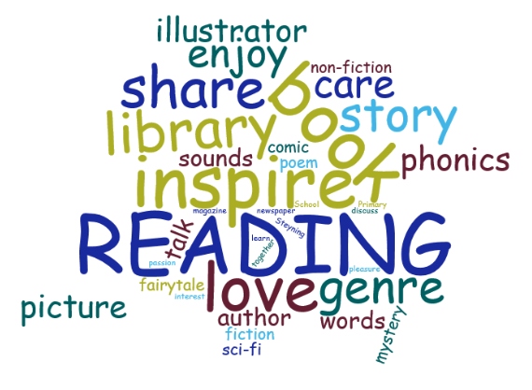
Reading Army
Could you help?
Are you able to offer anything from 1 hour per week to a couple of mornings / afternoons a week?
If so, please pop into the office to register your interest.

Slide 24
Before you go……
Please fill out a time and day for the Early Years team to come for a home visit in September
Thank you for choosing Steyning CofE Primary – we look forward to working with you
Thank you for coming!

