Slide 1



Welcome to the Year 3 and Year 4 Induction Meeting
“Do Everything in Love; we do our best in all we do and all we say with God’s help.”
CC

Slide 2


Aims of the meeting
Teaching staff for 2026/27
An introduction to this years themes
General information about the year ahead
To answer any questions you may have
CC
“Do Everything in Love; we do our best in all we do and all we say with God’s help.”

Slide 3
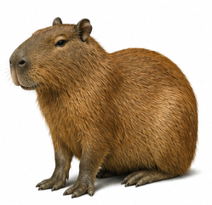
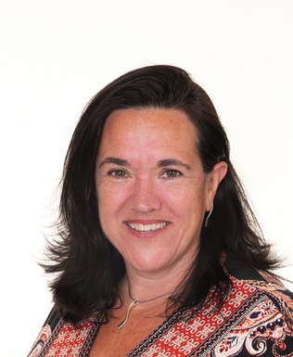
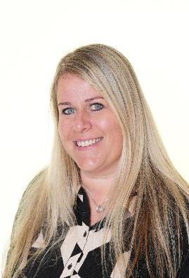
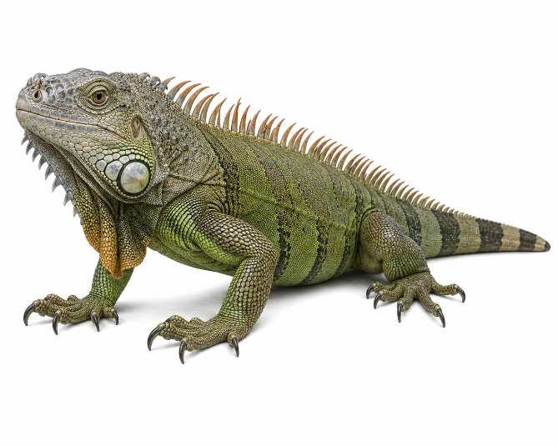
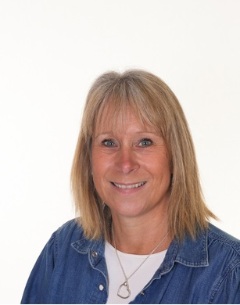
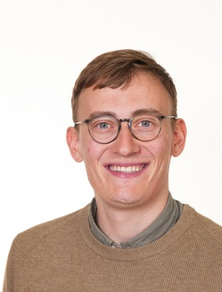
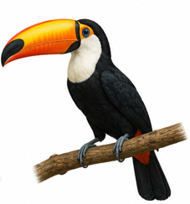
Year 3/4 Teachers
Claire Doyle & Lizzie Massbery
Cara Croke
Will Dyball
“Do Everything in Love; we do our best in all we do and all we say with God’s help.”
Notes:
Individual teachers

Slide 4
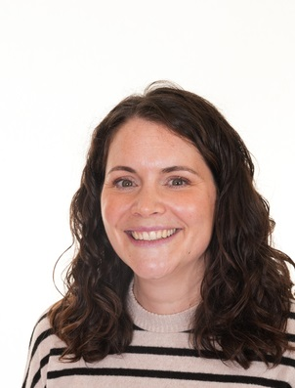
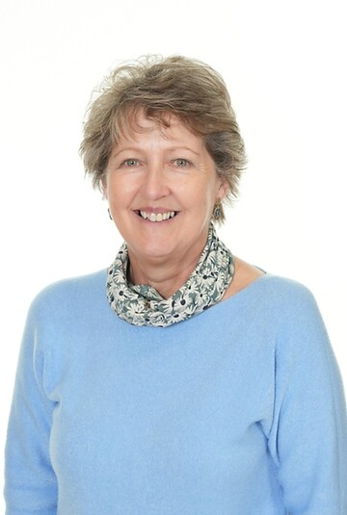
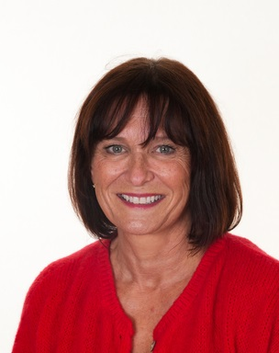
Year 3/4 LSAs
Michelle Bransbury
Sophia Duffett
Pam Willis
“Do Everything in Love; we do our best in all we do and all we say with God’s help.”
Notes:
Individual teachers

Slide 5
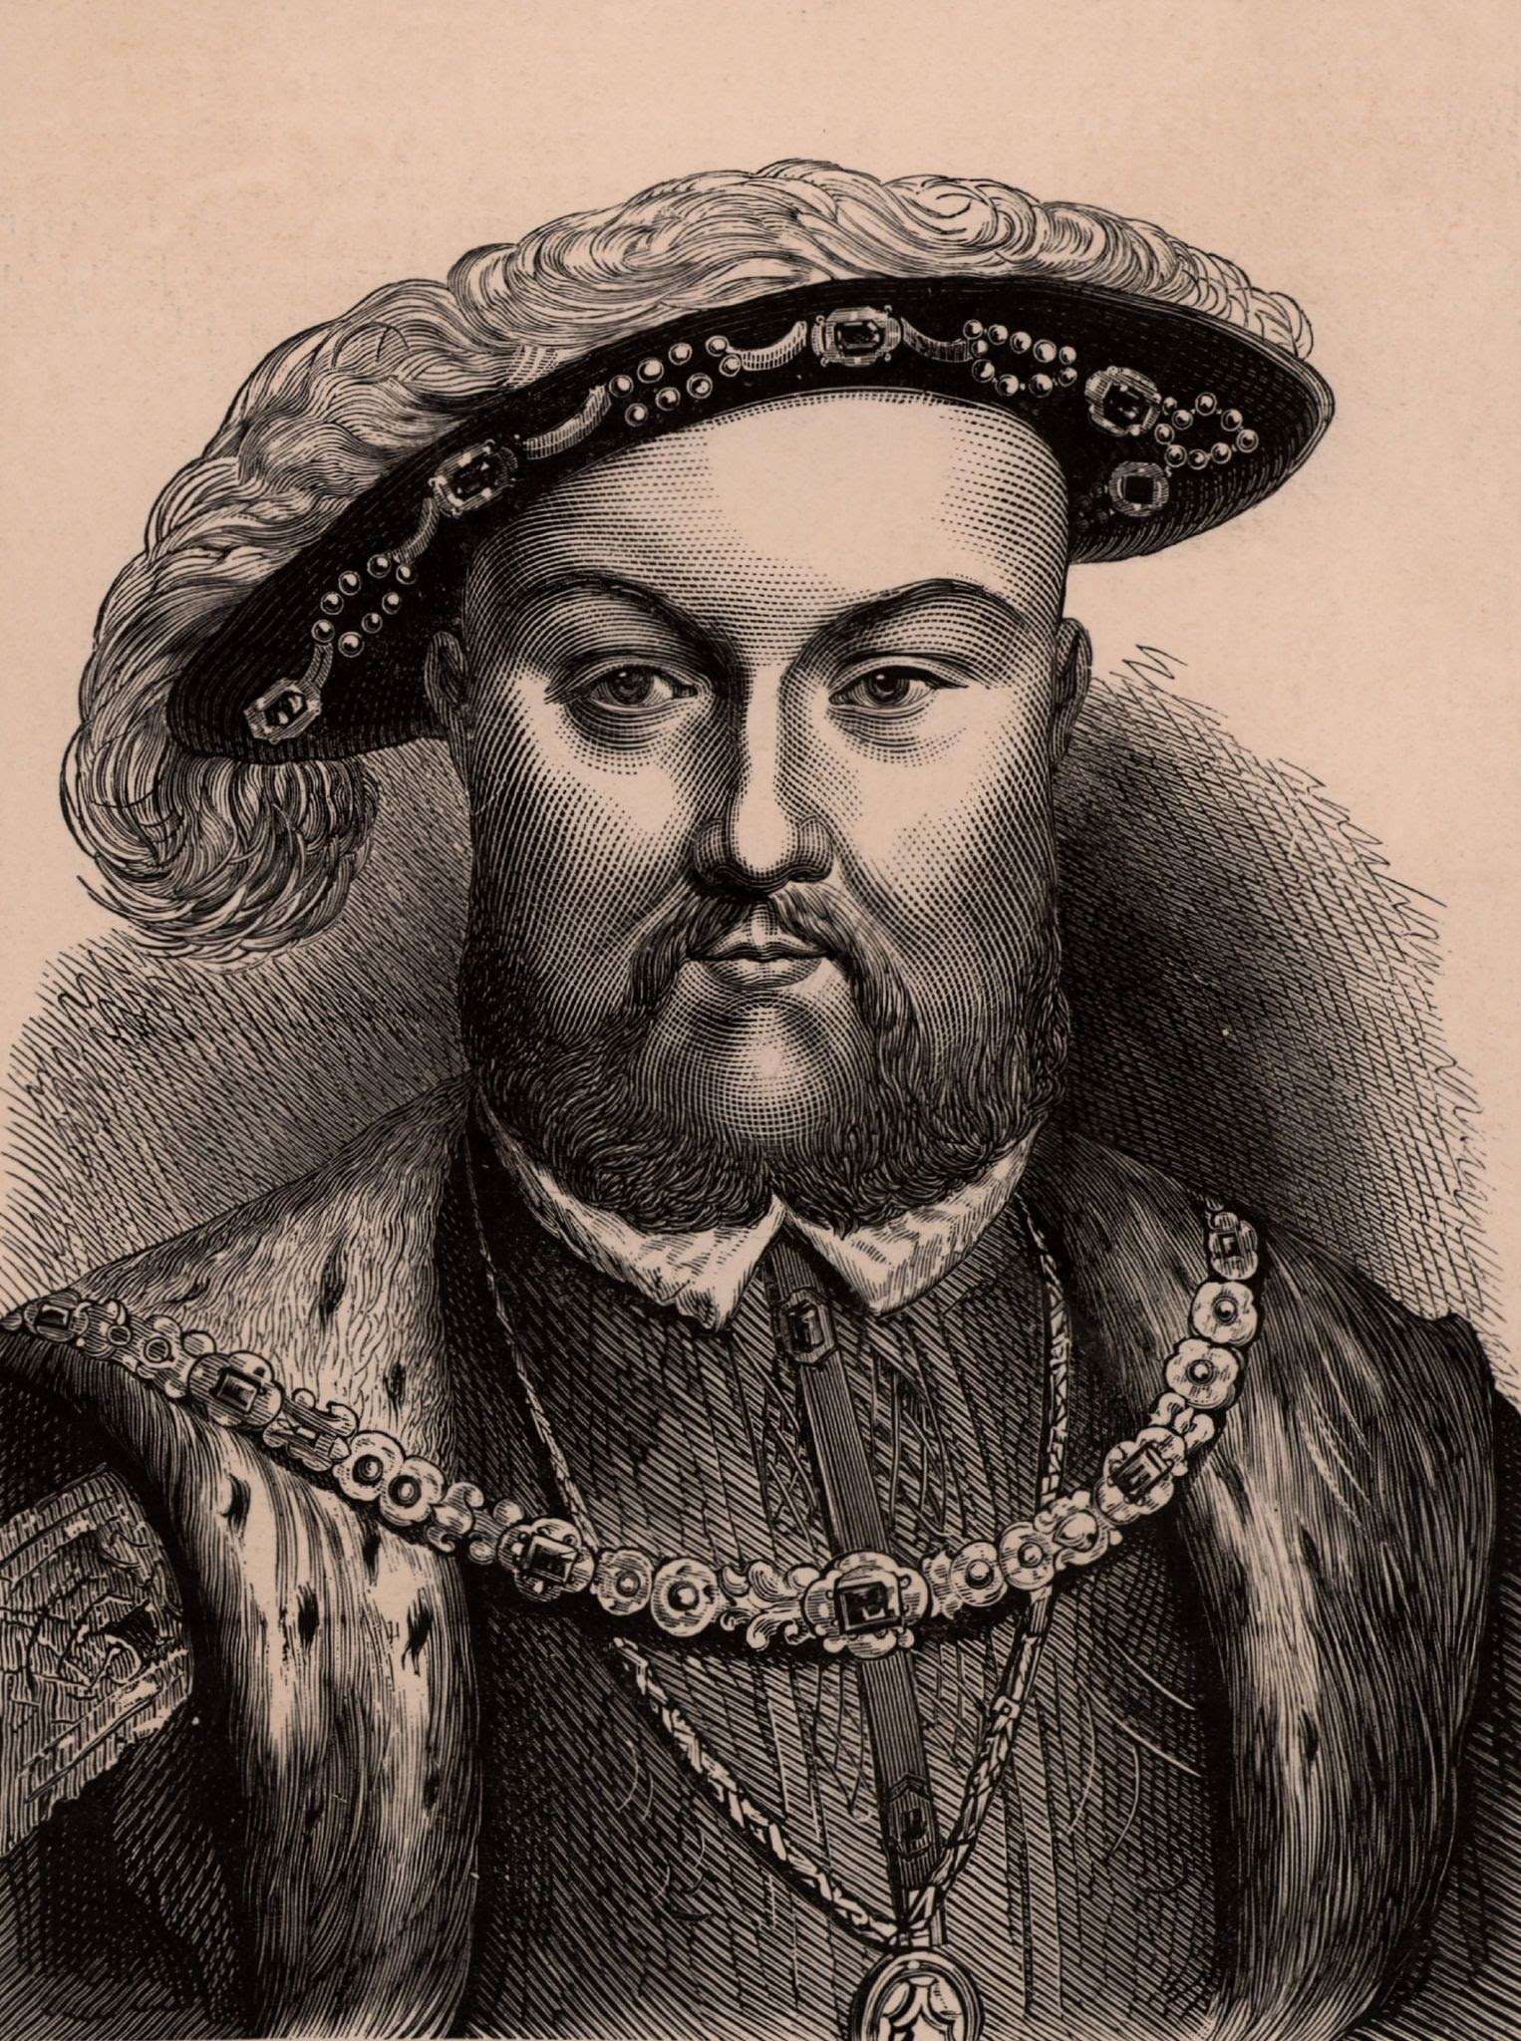

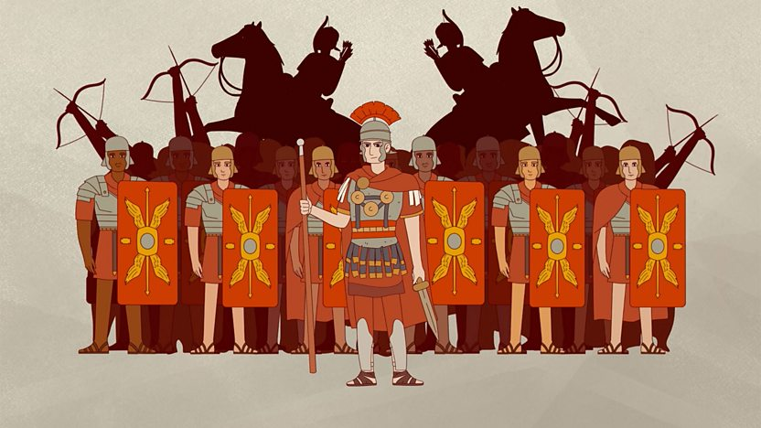
Year 3/4 Themes -Cycle A
Autumn Term
Empires and Invaders
The Roman Empire and its impact on Britain
Spring Term
Crown and Chaos
Tudors
Summer Term
Stars, Stripes and Stories
Native America
CC
“Do Everything in Love; we do our best in all we do and all we say with God’s help.”
Notes:
CD

Slide 6
Curriculum Enrichment in Year 3/4
Theme weeks focusing on our Wider World and Healthy Living
Swimming lessons
Nature School sessions
Author Visits
Library Visits
Steyning Church Visits
Easter production
Fishbourne Roman Palace
In School Residential for 1 night in the Summer Term
“Do Everything in Love; we do our best in all we do and all we say with God’s help.”
CC
Notes:
LM

Slide 7


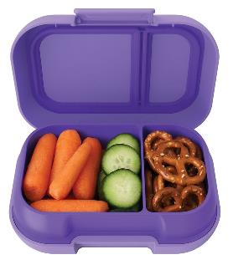
Daily Expectations
Each day, your child will need to bring in:
Named water bottle
Reading log and reading book
Healthy snack (this is NOT provided in Years 3 and 4 )
WD
“Do Everything in Love; we do our best in all we do and all we say with God’s help.”
Notes:
CD

Slide 8
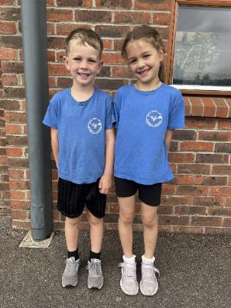
P.E
P.E kits are to be bought in at the beginning of each half term and will be sent home at the end of each half term.
Capybara Class
Tuesday and Thursday
Iguana Class
Tuesday and Friday
Toucan Class
Monday and Friday
Coloured T shirt (representing your child’s house colour)
Black shorts or skorts
Plimsolls or trainers
Jumper and Joggers/leggings for colder months
“Do Everything in Love; we do our best in all we do and all we say with God’s help.”
WD
Notes:
HR

Slide 9
Uniform
Clothing
Black trousers, shorts, skirt or pinafore
White polo shirt or shirt
Royal blue sweatshirt or cardigan (with or without school label)
Blue and white checked dress as a summer option
Plain white or black socks or tights
Shoes
Must wear all black shoes, boots or trainers.
No colour or logos (unless the logo is black)
Shoes must have no heel
Jewellery
Simple stud earrings (not dangling or hoops for safety reasons)
No chains or necklaces
A watch may be worn (no internet or phone-based can be worn)
Hair and Make-up
No make-up or nail varnish
WD
“Do Everything in Love; we do our best in all we do and all we say with God’s help.”
Notes:
LC

Slide 10
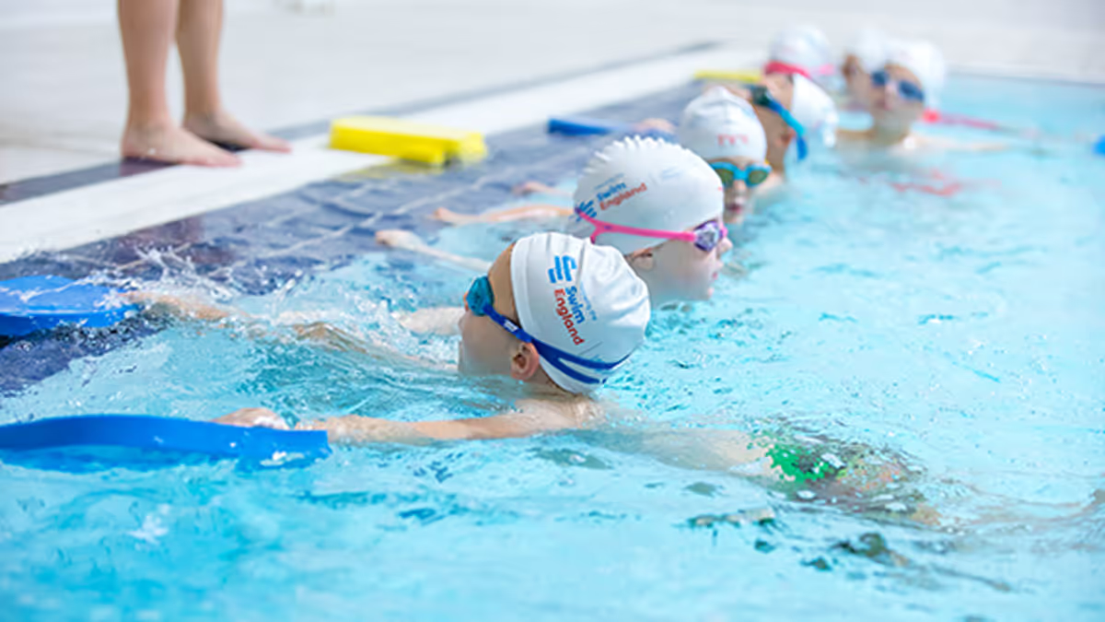
Swimming
Years 3 and 4 will have the opportunity to attend swimming sessions this year. This will happen in 6 week blocks, on Friday mornings
You will receive an email letting you know the dates that your child will be swimming.
Your child will need swim shorts or a swimming costume, towel and goggles. A swim hat is optional.
WD
“Do Everything in Love; we do our best in all we do and all we say with God’s help.”
Notes:
HW

Slide 11
A Typical Day in Year 3/4
Children welcomed each morning at the classroom door by the Teacher and TA
Guided Reading sessions
Morning and afternoon play
Spellings and Times Tables
Collective Worship
LM
“Do Everything in Love; we do our best in all we do and all we say with God’s help.”
Notes:
HW

Slide 12
What will it look like in Year
3/4?
Children will be taught according to their ability and stage of learning not their age, following the NC for that year group.
Children will complete learning tasks adapted to their ability this might be in groups, with an adult or independently.
LM
“Do Everything in Love; we do our best in all we do and all we say with God’s help.”
Notes:
CD

Slide 13
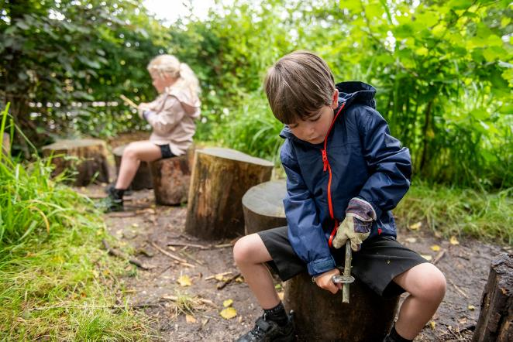
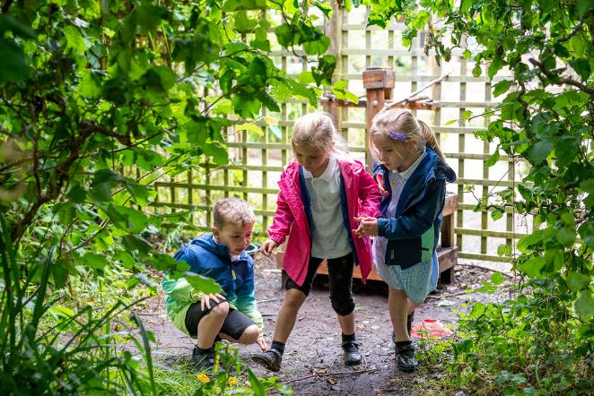
Nature School
Nature School sessions follow holistic child led approach, designed to allow children to learn about their natural environment and themselves through play. The activities provided such as green wood working, den building, mud play etc, provide the children with managed risks allowing them to build up personal resilience, confidence, self-esteem and communication skills.
Children are taken out rain or shine! The only weather conditions in which sessions won't go ahead are thunder and lightning storms or extreme winds.
LM
“Do Everything in Love; we do our best in all we do and all we say with God’s help.”

Slide 14
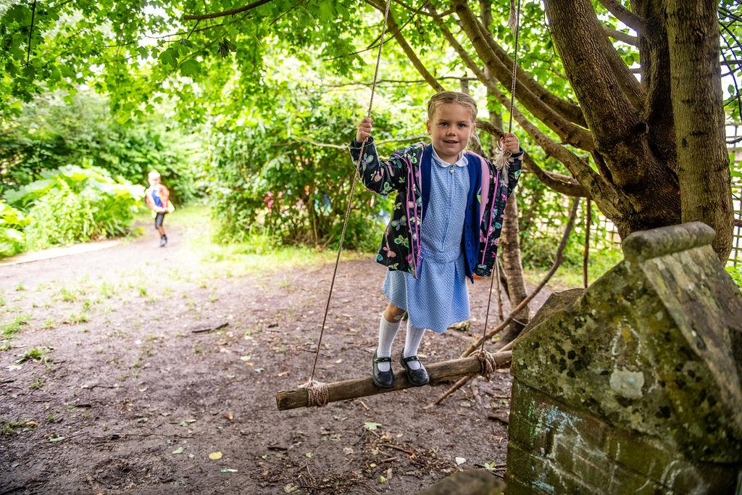
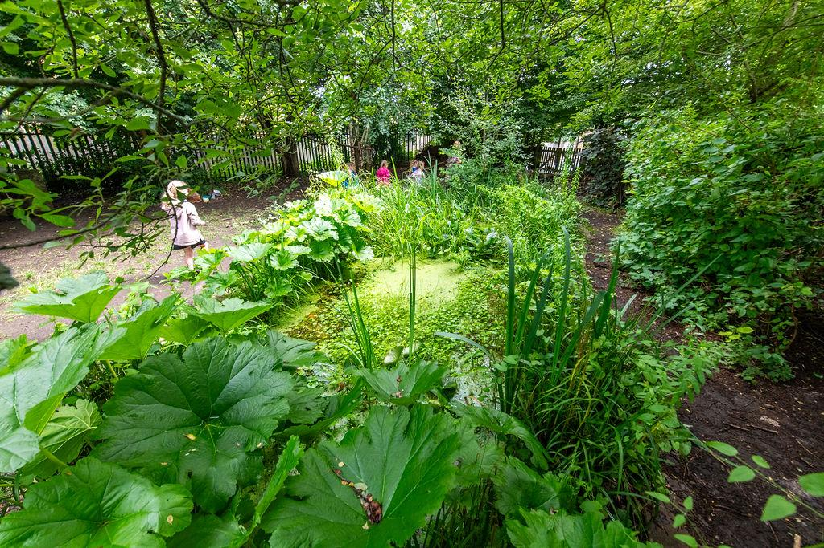
Nature School
Nature School clothes are to be bought in on the morning of the Nature School session. These dates will be sent to you via email. Children will change at school and be sent home in these clothes.
During hot sunny weather children should wear:
long light cotton trousers
light cotton socks
trainers or deck shoes
short sleeved or light cotton long sleeved shirts
sun hat
Protective sunscreen
During wet weather children should wear or bring with them:
a waterproof coat or jacket
waterproof trousers
and wellington boots.
LM
“Do Everything in Love; we do our best in all we do and all we say with God’s help.”
Notes:
LM

Slide 15

How to support your child at home
Learning Times Tables
Learning weekly spellings
TT Rockstars
Reading as often as you can, please make sure this is recorded in your child’s reading diary.
“Do Everything in Love; we do our best in all we do and all we say with God’s help.”
CD
Notes:
CC

Slide 16
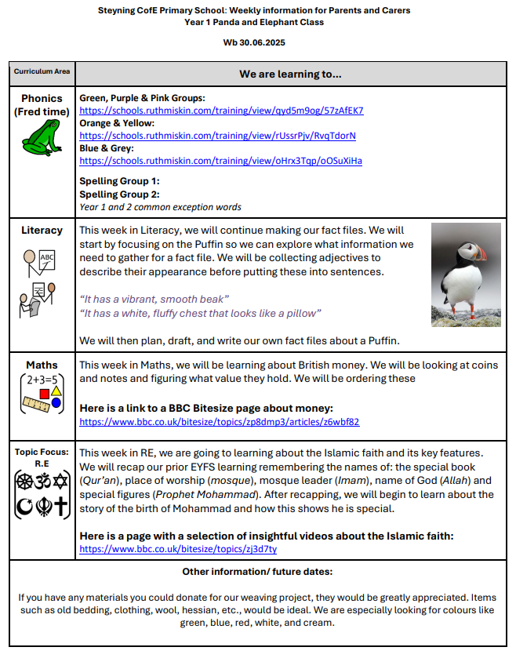
Communication
Weekly overviews of learning and reminders
Weekly parent/carer letter
Monthly SWAY
Email
office@steyningprimary.org.uk for enquiries for class teacher
CD
“Do Everything in Love; we do our best in all we do and all we say with God’s help.”

Slide 17
Assessments
All children in Year 3 and 4 will sit an assessment in Reading, Spelling, Punctuation and Maths each term.
The Year 4 children will sit the Multiplication Tables Check (MTC) which assesses their fluent recall of their times tables up to 12 times table in June 2027
CD
“Do Everything in Love; we do our best in all we do and all we say with God’s help.”

Slide 18

INSET days for 2026-7
Tuesday 1st September 2026
Tuesday 26th January 2027
Monday 19th July 2027
Tuesday 20th July 2027
Wednesday 21st July 2027
CD
“Do Everything in Love; we do our best in all we do and all we say with God’s help.”
Notes:
CC

Slide 19
Any questions?
CC
“Do Everything in Love; we do our best in all we do and all we say with God’s help.”
Notes:
CC

