Slide 1


Welcome to the
Year 1 and 2 Induction Meeting
“Do Everything in Love; we do our best in all we do and all we say with God’s help.”
Notes:
SN
Welcome to all familiar parents and carers to Key Stage 1 as well as all those with a child moving into Year 1 for the first time.
‹#›

Slide 2
Aims of the meeting
Teaching staff for 2026/7
An introduction to this year’s themes
Information about the year ahead
To answer questions you may have
SN
“Do Everything in Love; we do our best in all we do and all we say with God’s help.”
Notes:
SN
‹#›

Slide 3
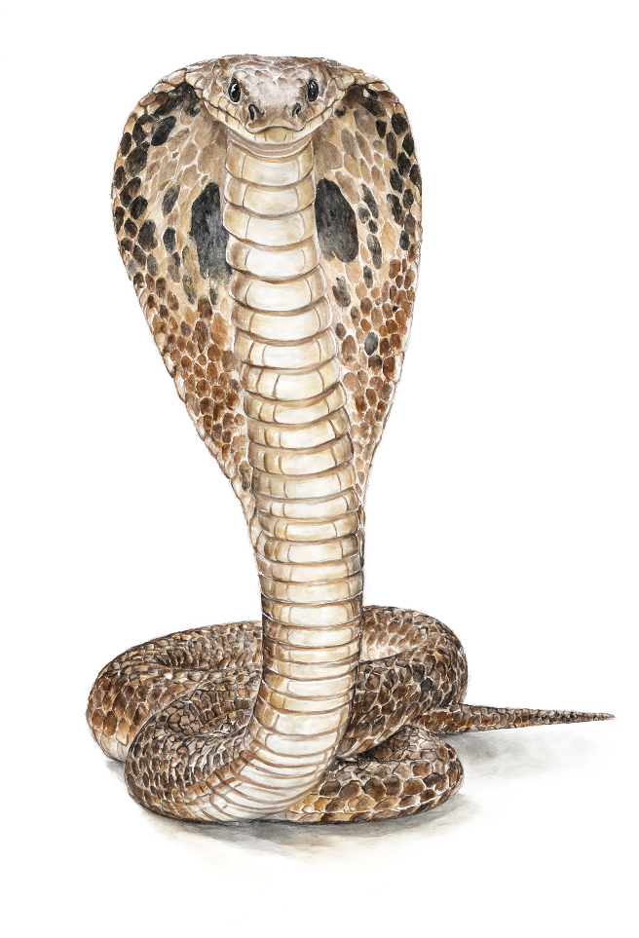

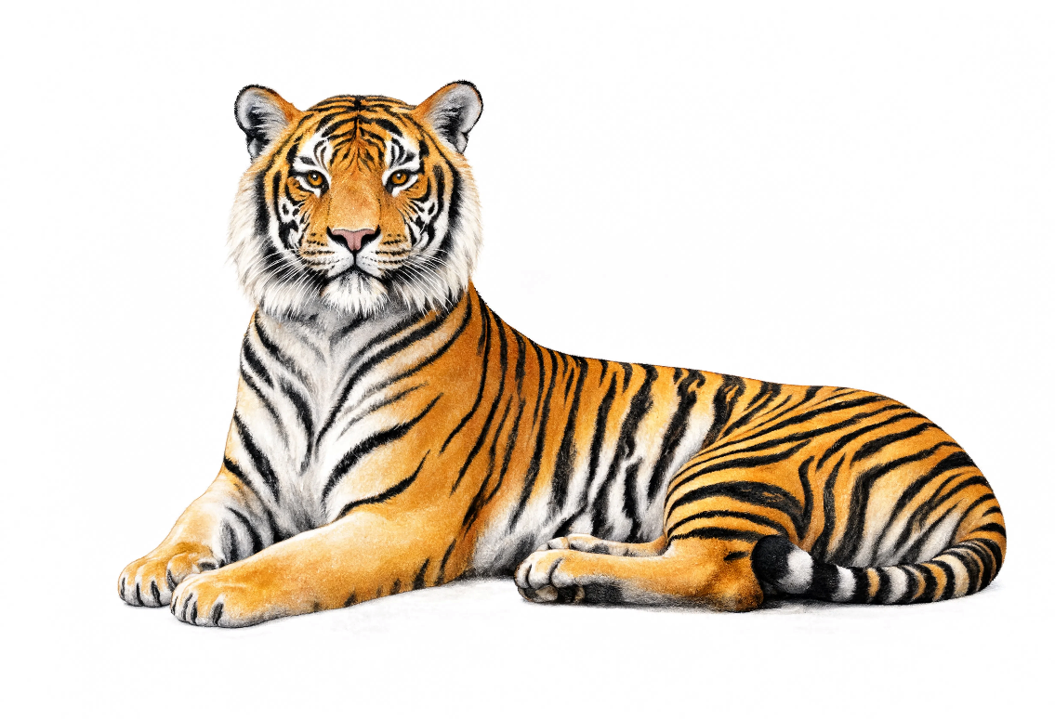
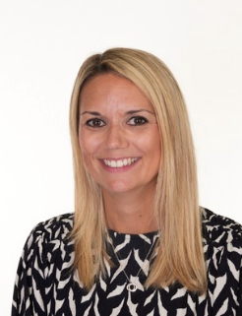
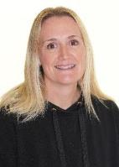
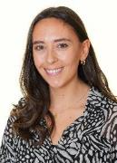
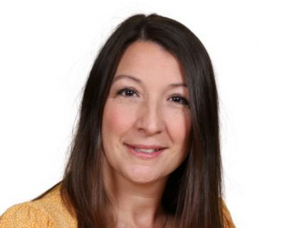
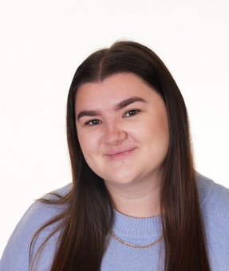
Year 1/ 2 Team
TBC
Jo Reed
Hannah Robinson
Verity Moran
Sophie Norbury
“Do Everything in Love; we do our best in all we do and all we say with God’s help.”
Notes:
SN
‹#›

Slide 4
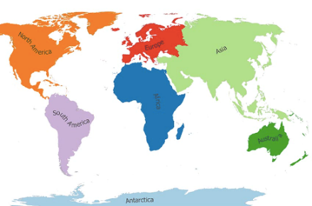
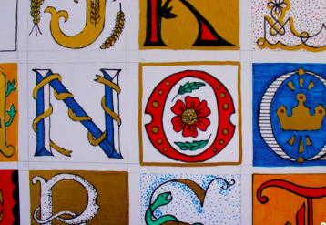
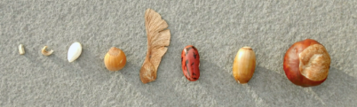
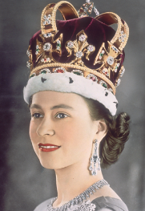
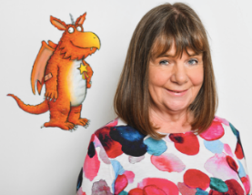
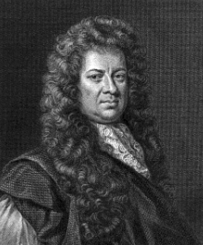
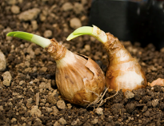
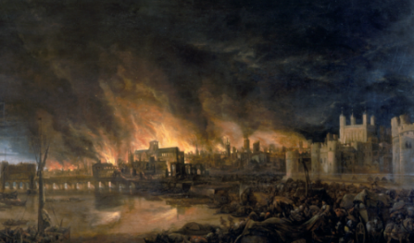
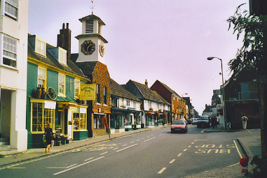
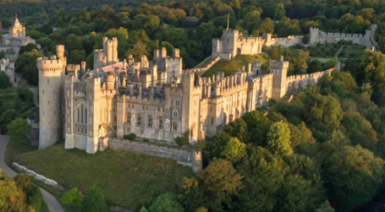
Year 1/2 Cycle A Themes
Autumn Term
‘Fire and Ice’
Spring Term
‘Kings, Queens
and Castles’
Summer Term
‘Beyond our
School Gate’
“Do Everything in Love; we do our best in all we do and all we say with God’s help.”
Notes:
‹#›

Slide 5
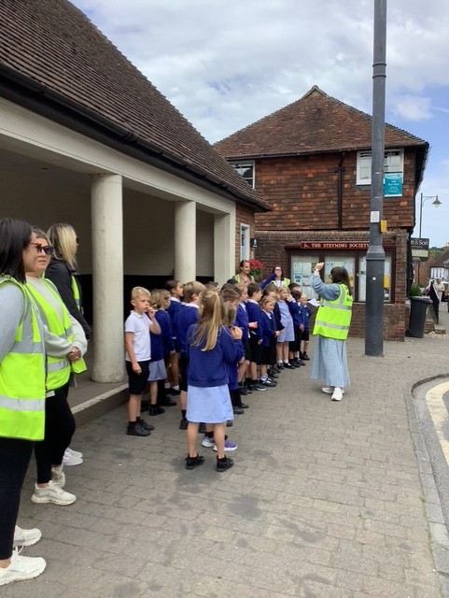
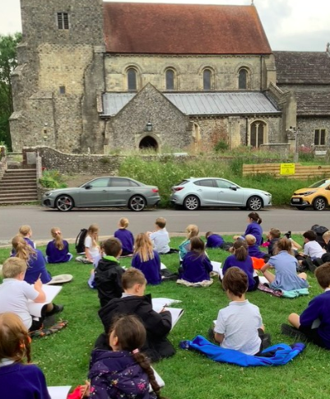
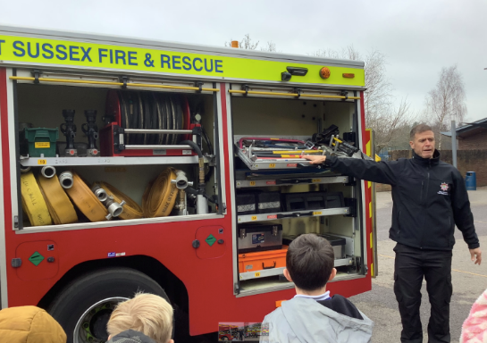
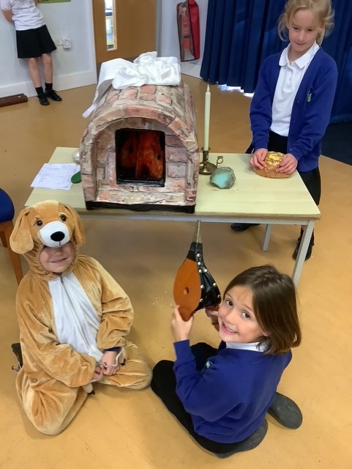
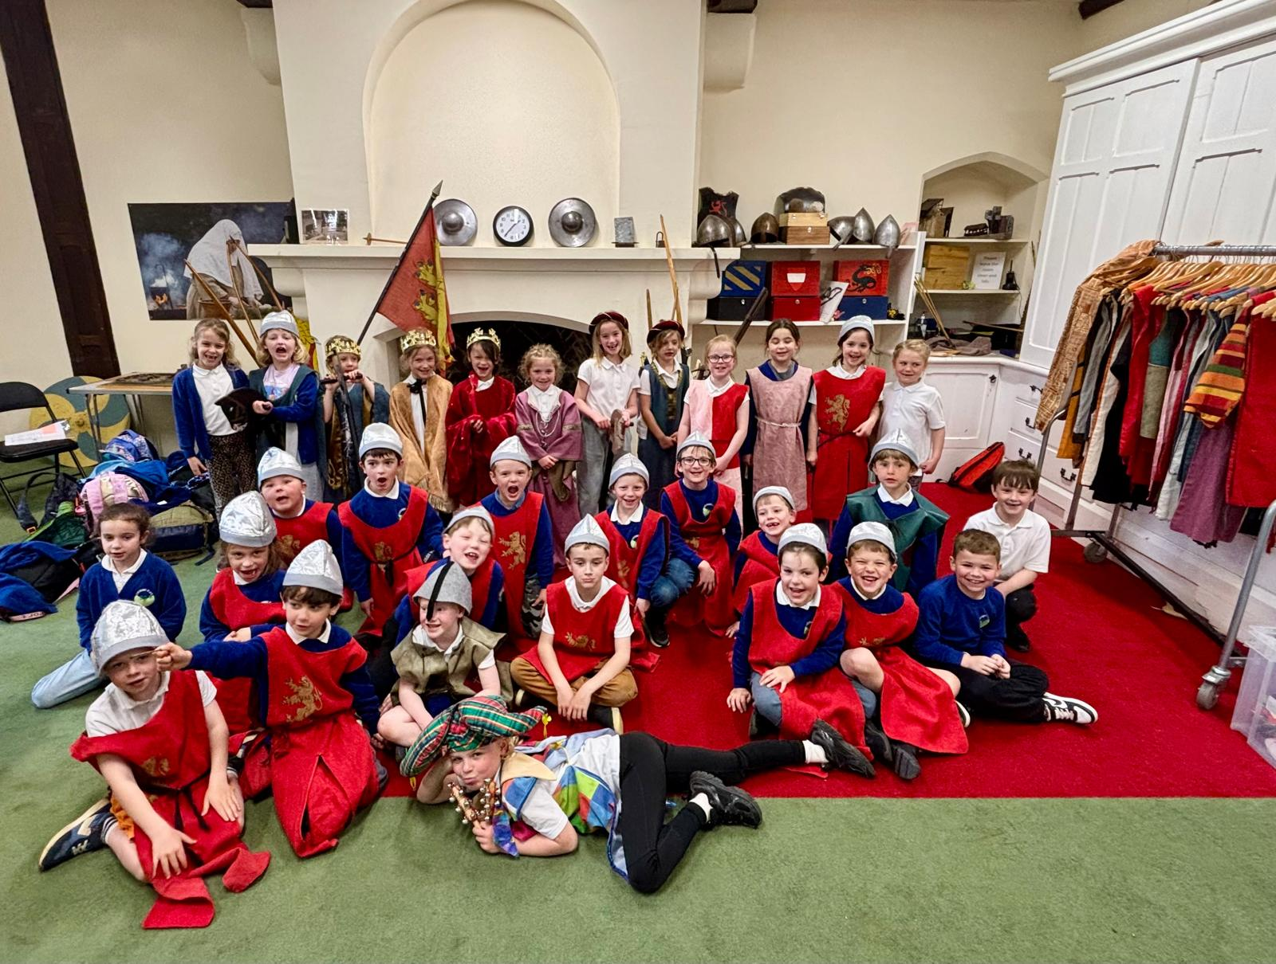
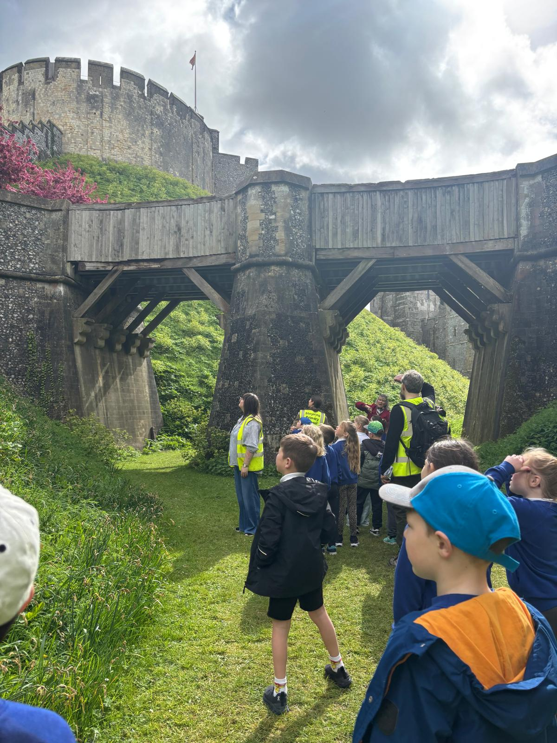
Curriculum Enrichment
Visit from the Fire service
Rainbow Theatre: Great Fire of London
Walks around Steyning
Arundel Castle
Theme Weeks: Our Wider World & Healthy Mind, Healthy Body
“Do Everything in Love; we do our best in all we do and all we say with God’s help.”
Notes:
‹#›

Slide 6


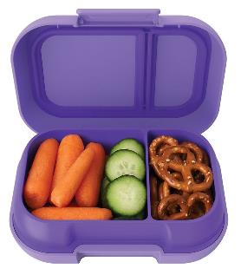
Daily Expectations
Each day, your child will need to bring in:
Named water bottle
Yellow reading log and reading book
Optional healthy snack (fruit and vegetables are provided)
“Do Everything in Love; we do our best in all we do and all we say with God’s help.”
Notes:
‹#›

Slide 7
Uniform
Clothing
Black trousers, shorts, skirt or pinafore
White polo shirt or shirt
Royal blue sweatshirt or cardigan (with or without school label)
Blue and white checked dress as a summer option
Plain white or black socks or tights
Shoes
Must wear all black shoes, boots or trainers.
No colour or logos (unless the logo is black)
Shoes must have no heel
Jewellery
Simple stud earrings (not dangling or hoops for safety reasons)
No chains or necklaces
A watch may be worn (no internet or phone-based can be worn)
Hair and Make-up
No make-up or nail varnish
“Do Everything in Love; we do our best in all we do and all we say with God’s help.”
Notes:
‹#›

Slide 8
P.E
P.E kits are to be bought in at the beginning of each half term and will be sent home at the end of each half term.
Coloured T-Shirt should be the same as your child’s house colour
Black shorts or skorts
Plimsolls or trainers
Jumper and joggers/ leggings for colder months
Children will be changed in class, on their corresponding P.E days
Monday & Thursday
Wednesday & Thursday
Tuesday & Thursday
“Do Everything in Love; we do our best in all we do and all we say with God’s help.”
Notes:
‹#›

Slide 9
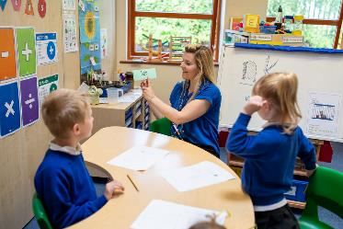
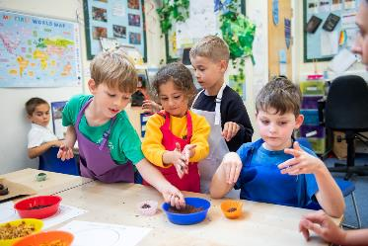
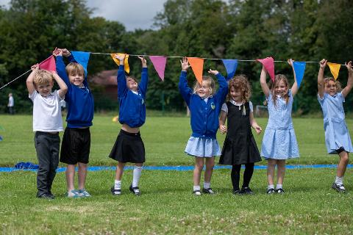
A typical day in Year 1/2
Children welcomed each morning with a calm start, with activities such as practising CEW spellings, or number bonds.
Daily 45 min phonic lessons
Collective Worship
Morning and afternoon play
Daily story time
“Do Everything in Love; we do our best in all we do and all we say with God’s help.”
Notes:
‹#›

Slide 10
What will it look like in the classroom?
Children will be taught according to their ability and stage of learning not their age, following the National Curriculum for that year group.
Children will complete learning tasks in adult led groups, or independently. This will vary in relation to the task, and their ability.
There will be tasks which consolidate prior learning in the classroom environment for all to access.
“Do Everything in Love; we do our best in all we do and all we say with God’s help.”
Notes:
‹#›

Slide 11
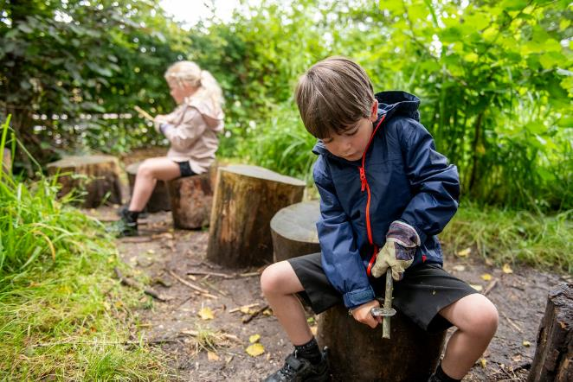
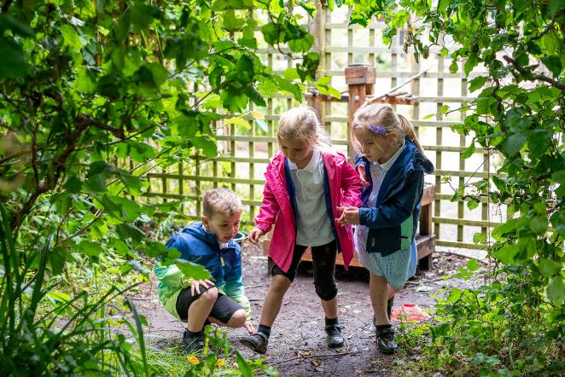
Nature School
Nature School sessions follow holistic child led approach, designed to allow children to learn about their natural environment and themselves through play. The activities provided such as green wood working, den building, mud play etc, provide the children with managed risks allowing them to build up personal resilience, confidence, self-esteem and communication skills.
Children are taken out rain or shine! The only weather conditions in which sessions won't go ahead are thunder and lightning storms or extreme winds.
Dates of your child’s Nature School sessions will be emailed each half term.
“Do Everything in Love; we do our best in all we do and all we say with God’s help.”
Notes:
‹#›

Slide 12
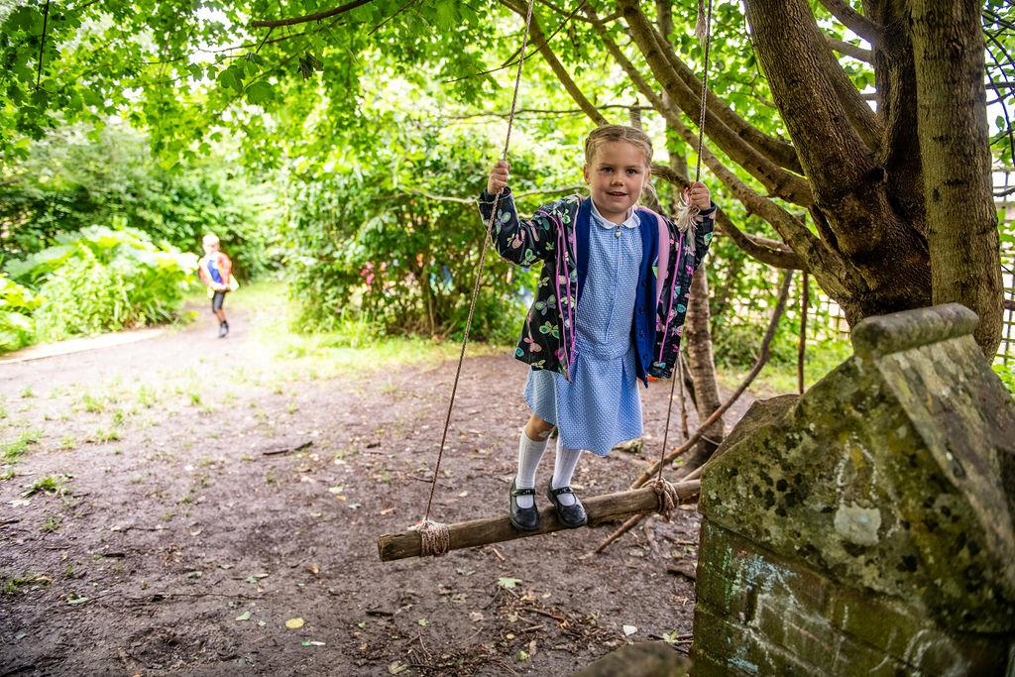
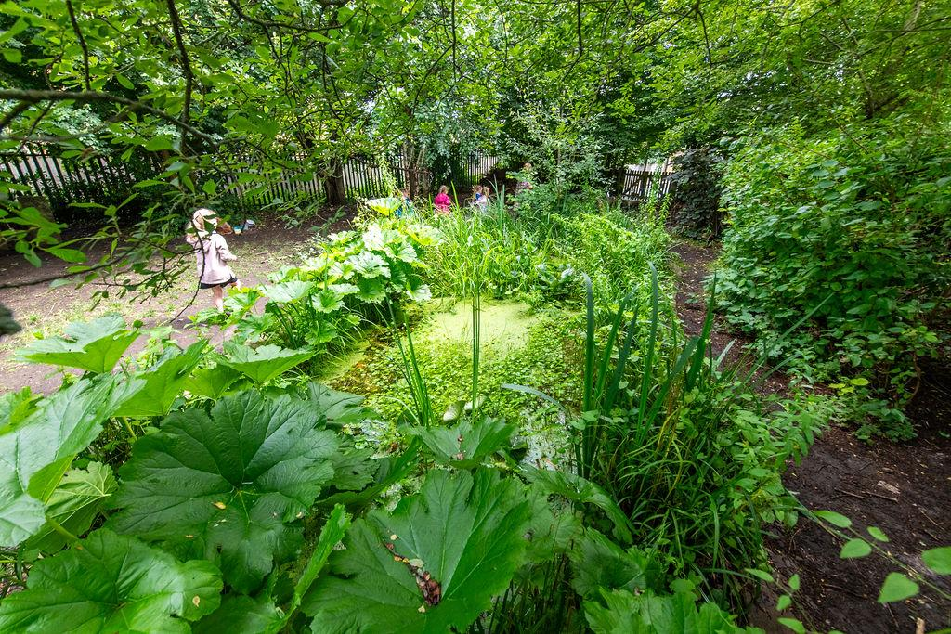
Nature School
Nature School clothes are to be bought in each week on the morning of the Nature School session. Children will change at school and be sent home in these clothes.
During hot sunny weather children should wear:
long light cotton trousers
light cotton socks
trainers or deck shoes
short sleeved or light cotton long sleeved shirts
sun hat
protective sunscreen
During wet weather children should wear or bring with them:
a waterproof coat or jacket
waterproof trousers
wellington boots
“Do Everything in Love; we do our best in all we do and all we say with God’s help.”
Notes:
‹#›

Slide 13



Reading
Reading is one of the most crucial skills children learn during their time in primary school.
We ask that you find time to regularly read with your child,
at least 3 times a week.
“Do Everything in Love; we do our best in all we do and all we say with God’s help.”
Notes:
‹#›

Slide 14





Reading
This can be done in lots of different ways:
Listening to your child reading aloud to you.
You can read to them (a school reading book, library book, or a book above their phonetic level).
Book talk- discussing what you have read together.
“Do Everything in Love; we do our best in all we do and all we say with God’s help.”
Notes:
‹#›

Slide 15

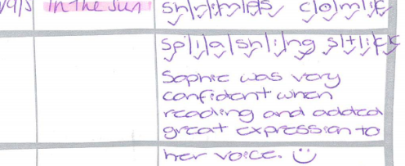
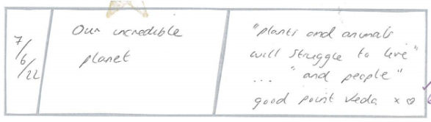

“I think this is a fact book because it is about plants”
“… used Fred talk to sound out t-ee-th”
“I predict that Jarvis will start barking. He looks like a cheeky dog!”
“Do Everything in Love; we do our best in all we do and all we say with God’s help.”
Notes:
‹#›

Slide 16





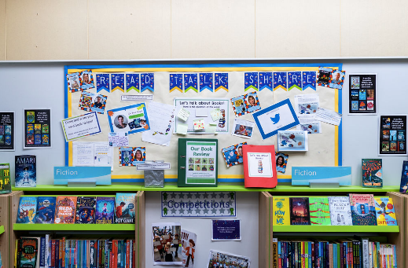
Monday
RWI book bag book
Friday
RWI (Fred time) book
“Do Everything in Love; we do our best in all we do and all we say with God’s help.”
Notes:
‹#›

Slide 17
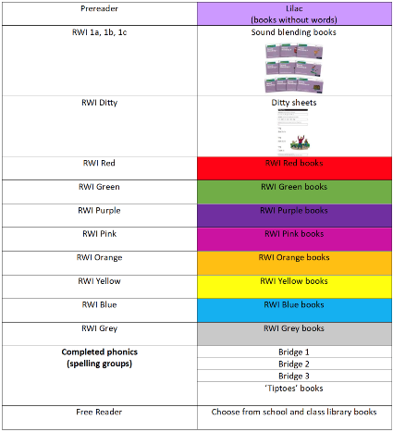

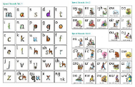
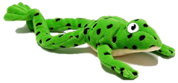
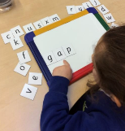

Phonics (Fred Time)
“Do Everything in Love; we do our best in all we do and all we say with God’s help.”
Notes:
‹#›

Slide 18
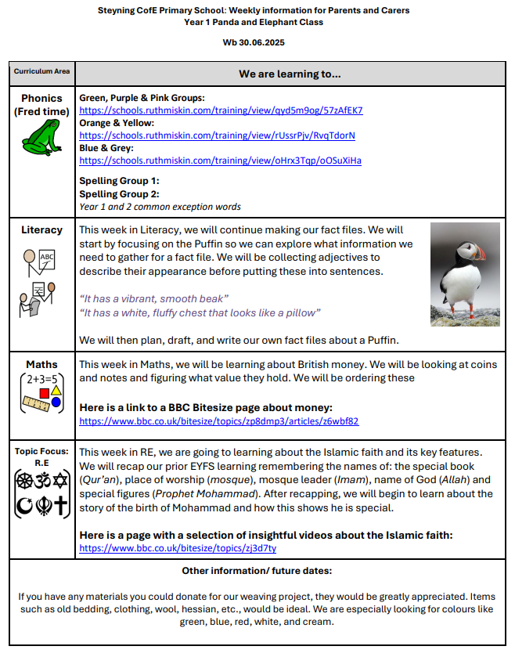
Communication
Weekly overviews of learning and reminders
Weekly parent/ carer letter
Monthly ‘Round Up’
Email office@steyningprimary.org.uk for enquiries for your class teacher
“Do Everything in Love; we do our best in all we do and all we say with God’s help.”
Notes:
‹#›

Slide 19
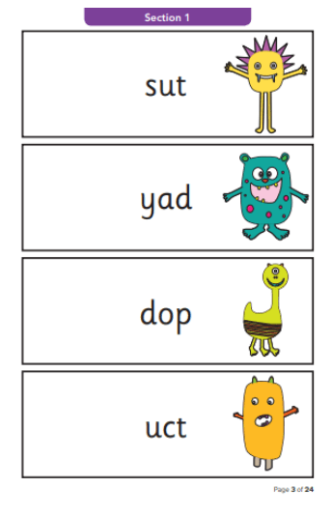
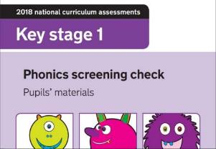
Primary Assessments
Year 1 Phonics screening June 2027
Children will sit their first assessment paper(s) in Summer term of Year 2. These are in Reading, Maths, Spelling and Punctuation.
“Do Everything in Love; we do our best in all we do and all we say with God’s help.”
Notes:
‹#›

Slide 20

INSET days for 2026-7
Tuesday 1st September 2026
Tuesday 26th January 2027
Monday 19th July 2027
Tuesday 20th July 2027
Wednesday 21st July 2027
“Do Everything in Love; we do our best in all we do and all we say with God’s help.”
Notes:
‹#›

Slide 21
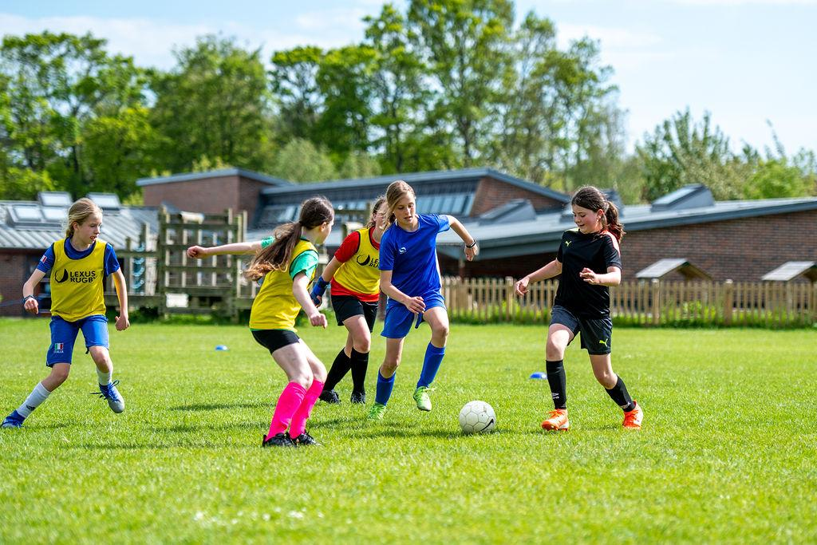
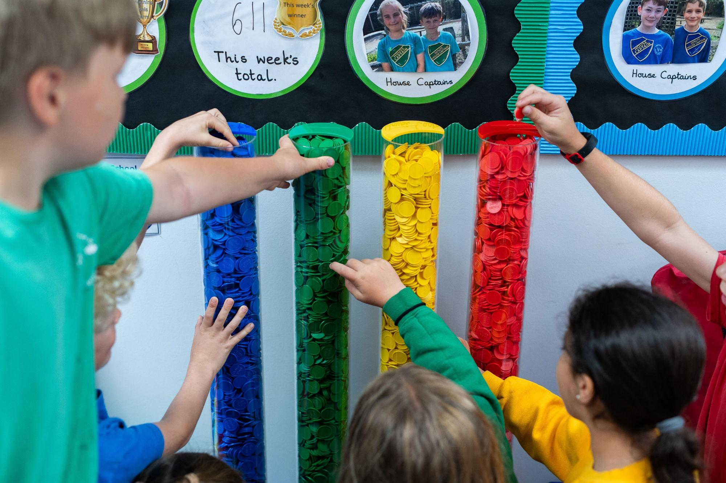
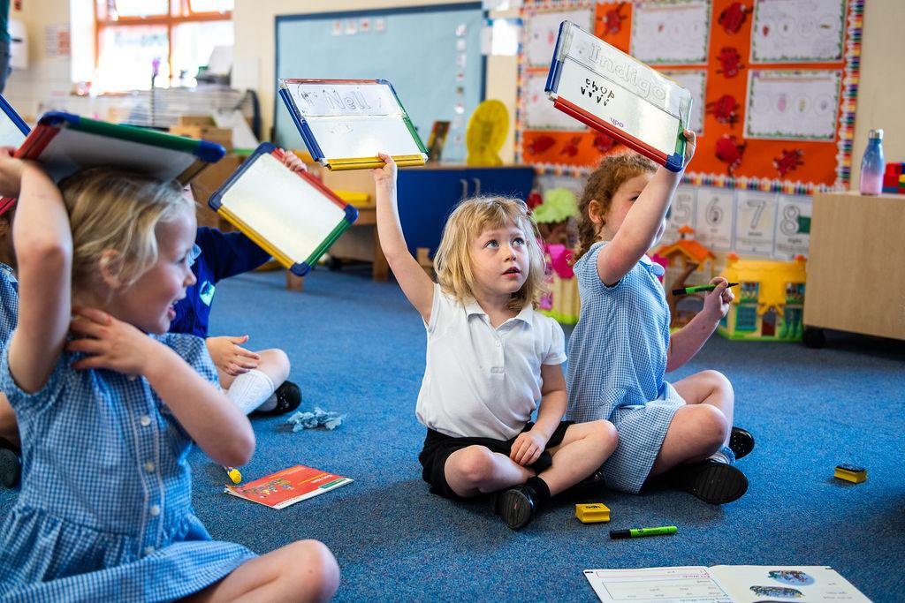
Any questions?
“Do Everything in Love; we do our best in all we do and all we say with God’s help.”
Notes:
‹#›

