Slide 1

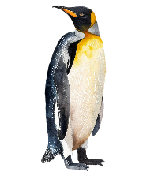


Welcome to the
Year 6 Induction Meeting
“Do Everything in Love; we do our best in all we do and all we say with God’s help.”

Slide 2
Aims of the meeting
Teaching staff for 2024/25
An introduction of Autumn term topics
General information about the year ahead
To answers any questions you may have
See your child’s classroom for next year
“Do Everything in Love; we do our best in all we do and all we say with God’s help.”

Slide 3
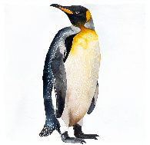
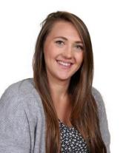
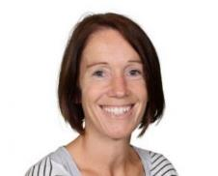
Year 6 Teachers and Teaching Assistants
Penguins Class
Ruth Dillingham
Claire Ridley
“Do Everything in Love; we do our best in all we do and all we say with God’s help.”

Slide 4
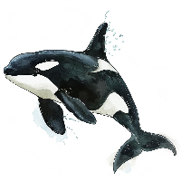
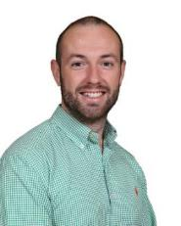
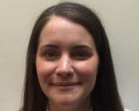
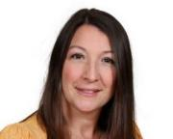
Year 6 Teachers and Teaching Assistants
Orcas Class
Peter Carter
Sophia Duffett
Becky Hocking
“Do Everything in Love; we do our best in all we do and all we say with God’s help.”

Slide 5



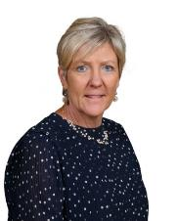
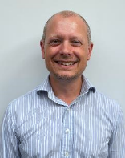
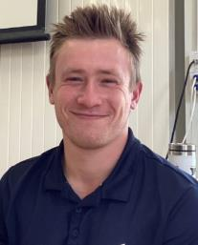
Specialist Teachers
Mr Mott
Madame Shipp
Mr Lelliott
“Do Everything in Love; we do our best in all we do and all we say with God’s help.”
Notes:
All children in KS1 receive a half an hour, weekly French lesson taught by Madame Shipp. These lessons are engaging and fun and progressive through the school.
As well as French, we also have our specialist teachers Mr Lelliot who teaches KS1 classes once a week, and Mr Mott who does the same for Music.
During PE, Mr Lelliot teaches the children core skills such a ball handling, gymnastics, dance and athletics. Within Music, Mr Mott will develop their signing, rhythm and instrument skills. The children love these lessons as they get to explore a range of different instruments.

Slide 6
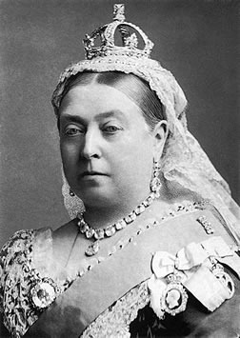
Autumn 1 topic
Revolution
History based topic
“Do Everything in Love; we do our best in all we do and all we say with God’s help.”

Slide 7
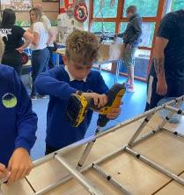
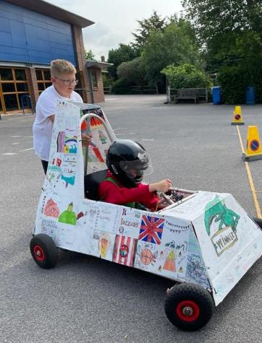
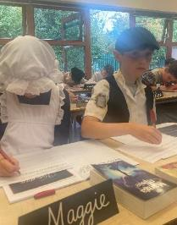
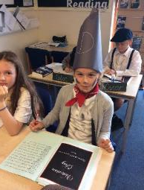
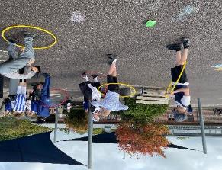
Curriculum Enrichment
Green Goblins
Victorian day
“Do Everything in Love; we do our best in all we do and all we say with God’s help.”

Slide 8
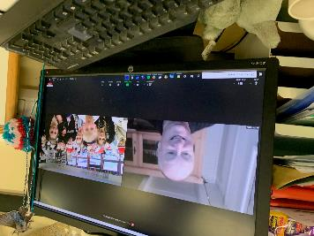
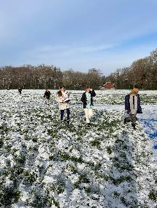

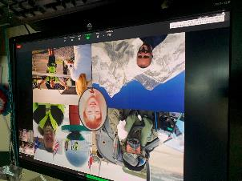
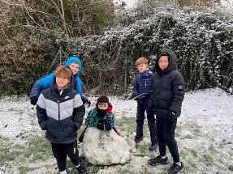
Curriculum Enrichment
Bikeability
Explorer day
“Do Everything in Love; we do our best in all we do and all we say with God’s help.”

Slide 9
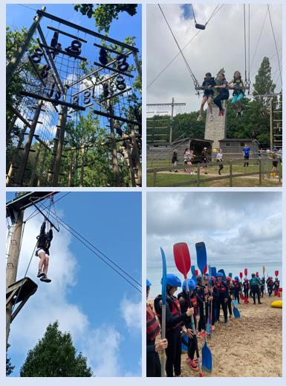
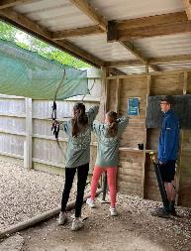
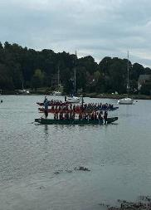
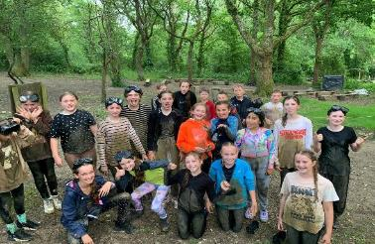
Isle of Wight Residential
You will receive more information about this next year.
“Do Everything in Love; we do our best in all we do and all we say with God’s help.”

Slide 10
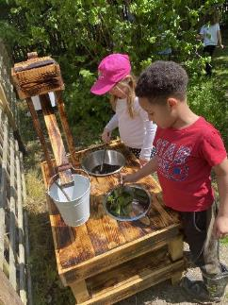
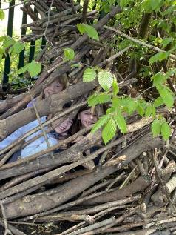
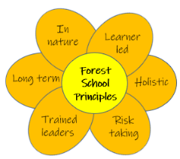
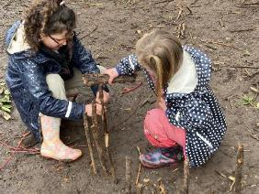
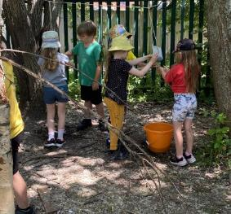
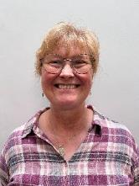
Forest School
Notes:
Each class will receive a half term block of Forest School with our Forest School Facilitator Mrs McNie.
Within these session the children are allowed to explore our wonderful Forest School environment and learn new skills such as whittling, den making, pond dipping and so on.
A letter will be sent out in the coming weeks asking for parent volunteers so if this is something you might want to help with, please look out for the email.
On your child forest school days please provide clothing that you don’t mind getting messy for them to change into or waterproof clothing.
Check the weather forecast to enable the appropriate clothing e.g. wellies and a waterproof coat in the winter months and hats in the summer months.

Slide 11

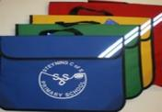


Daily Expectations
Each day, your child will need to bring in:
Reading books and reading journals
Water Bottles
Healthy snack
Appropriate P.E kit (on PE days) or uniform
“Do Everything in Love; we do our best in all we do and all we say with God’s help.”
Notes:
KH
Each day, please send in: bookbags, yellow reading logs, water bottles and a healthy snack.
Free snacks are provided in KS1, normally a piece of fruit or vegetable but these are in addition to not instead of what they bring in from home
Please check and recheck labels on all clothes
There are 2 short playtimes per day and a lunchtime play everyday

Slide 12
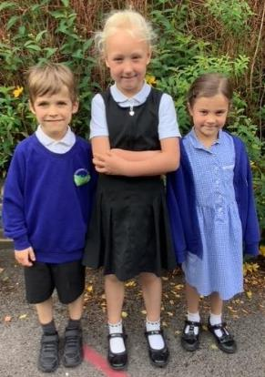
Daily Uniform
Clothing
Black trousers, shorts, skirt or pinafore
White polo shirt or shirt
Royal blue sweatshirt or cardigan (with our without school label)
Blue and white checked dress as a summer option
Plain white or black socks or tights
Shoes
Must wear all black shoes, boots or trainers.
No colour or logos (unless the logo is black)
Shoes must have no heel.
“Do Everything in Love; we do our best in all we do and all we say with God’s help.”
Notes:
JH

Slide 13
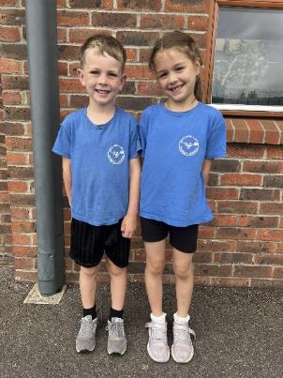
P.E Uniform
P.E Kit
Named clothing worn on P.E days must correspond to your child’s team colour
Black shorts or skorts
Plimsolls or trainers
Children should arrive to school in the correct uniform on their P.E days
Jewellery
Simple stud earrings (not dangling or hoops for safety reasons)
No chains or necklaces
A watch may be worn (no internet or phone-based can be worn)
Hair and Make-up:
No make-up or nail varnish
“Do Everything in Love; we do our best in all we do and all we say with God’s help.”
Notes:
JH

Slide 14



How to support your child at home
Learning Times Tables
TT Rockstars
Reading at least 3 times a week, please make sure this is recorded in your child’s reading diary.
Each class will be sending home a weekly overview of that week’s learning for you to support your children at home
Year 6 will receive revision guides in preparation for SATs this will happen in the Spring term and will be set weekly.
“Do Everything in Love; we do our best in all we do and all we say with God’s help.”

Slide 15
SATS Week
12th May 2025
MONDAY – THURSDAY
2 GPS (1 Spelling + 1 Grammar and Punctuation)
3 Maths (1 arithmetic + 2 reasoning)
1 Reading
You will receive more information about this next year.
“Do Everything in Love; we do our best in all we do and all we say with God’s help.”

Slide 16
Key dates
Year 6 Bikeability – WB 10th March 2025
Year 6 SATs Week – WB 12th May 2025
Year 6 Isle Of Wight – Sunday 15th – Wednesday 18th June
Growth and Development Week – June 2025
Year 6 Green Goblins – June 2025
Y6 Transition day to SGS – TBC
Year 6 Leavers Production – July 2025
“Do Everything in Love; we do our best in all we do and all we say with God’s help.”

Slide 17

INSET days for 2024/25
Monday 2nd September 2024
Tuesday 3rd September 2024
Friday 25th October 2024
Tuesday 22nd July 2025
One TBC inset day
“Do Everything in Love; we do our best in all we do and all we say with God’s help.”
Notes:
SN

Slide 18


Information Booklets
The teaching team around your child.
Key objectives for reading, writing, maths and spellings for each year group.
Our school behaviour system.
Information on E-safety.
Yearly topic overview.
“Do Everything in Love; we do our best in all we do and all we say with God’s help.”
Notes:
SN This will be sent home with your child on 14th July

Slide 19

Reading Army
As part of our continued efforts to raise the standards of literacy in school and promote the love of reading, we need your help to grow our Reading Army in 2024-2025!
Here at Steyning Primary we strongly believe in the importance of building a love of reading from a very early age. The teaching of reading starts as soon as the children join us in Reception through high-quality phonics lessons and through the sharing of exciting texts.
By the time the children leave us in Year 6, we would like every child to not only be confident and able readers, but to also have developed a love of reading that will last a lifetime!
Could you help?
Are you able to offer anything from 1 hour a week to a couple of mornings / afternoons a week?
If so, please take an information leaflet and register your interest to join our ever-growing team.
“Do Everything in Love; we do our best in all we do and all we say with God’s help.”
Notes:
BG

Slide 20
You will now have time to speak to your child’s new class teacher.
Thank you.
“Do Everything in Love; we do our best in all we do and all we say with God’s help.”
Notes:
SN

