Slide 1



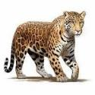

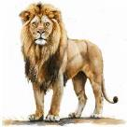
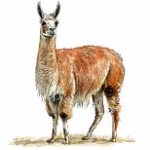
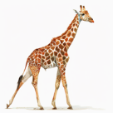

Welcome to the Year 3, Year 4 and Year 5 Transition Meeting
“Do Everything in Love; we do our best in all we do and all we say with God’s help.”
CC

Slide 2
Aims of the Meeting
To meet the new staff and classrooms
An introduction to Autumn Term topics
General Information about Year 3, Year 4 and Year 5
To answer any questions
“Do Everything in Love; we do our best in all we do and all we say with God’s help.”
CC

Slide 3


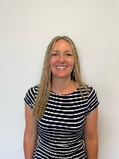
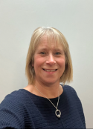

KS2 Teachers and Teaching Assistants
Llamas Class
Teacher
Cara Croke
Teaching Assistant
Nina Hempleman
CC
“Do Everything in Love; we do our best in all we do and all we say with God’s help.”

Slide 4

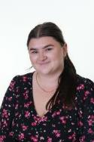
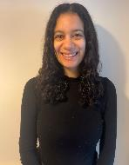
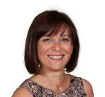
KS2 Teachers and Teaching Assistants
Jaguars Class
Teacher
Hannah Robinson
Teaching Assistant
Michelle Bransbury
Learning Support Assistant
Kaiya Jackson
HR
“Do Everything in Love; we do our best in all we do and all we say with God’s help.”

Slide 5
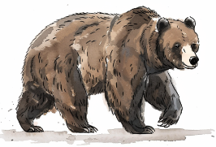
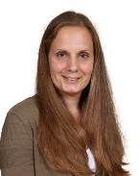
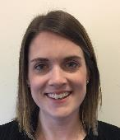
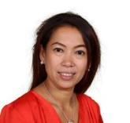
KS2 Teachers and Teaching Assistants
Bears Class
Teacher
Hayley Thorpe
Teacher
Hannah Wetjen
Teaching Assistant
Astuti Young
HW
“Do Everything in Love; we do our best in all we do and all we say with God’s help.”

Slide 6
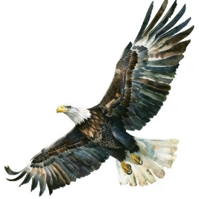
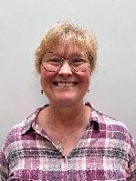
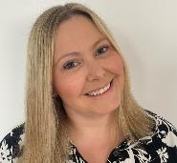
KS2 Teachers and Teaching Assistants
Eagles Class
Teacher
Lisa Coles
Teaching Assistant
Heidi McNie
LC
“Do Everything in Love; we do our best in all we do and all we say with God’s help.”

Slide 7

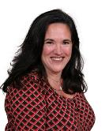
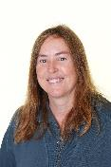
KS2 Teachers and Teaching Assistants
Giraffes Class
Teacher
Claire Doyle
Teacher
Tracy Salmon
Teaching Assistant
Lisa Funnell
CD
“Do Everything in Love; we do our best in all we do and all we say with God’s help.”

Slide 8

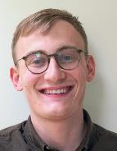
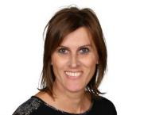
KS2 Teachers and Teaching Assistants
Lions Class
Teacher
Will Dyball
Teaching Assistant
Sarah Liddiard
WD
“Do Everything in Love; we do our best in all we do and all we say with God’s help.”

Slide 9
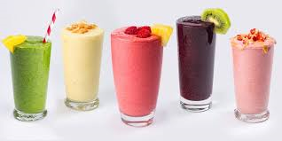
Year 3 Topics
Year 3 – Autumn Term
Scrumdiddlyumptious!
Guided Reading Book – Charlie and the Chocolate Factory by Roald Dahl
“Do Everything in Love; we do our best in all we do and all we say with God’s help.”
HR

Slide 10
Curriculum Enhancement in Year 3
Smoothie Café (making our own smoothies)
Career Day
Author Visits
Library Visits
Steyning Church
Butser Ancient Farm
Making robots and magnet mazes
Forest School sessions
“Do Everything in Love; we do our best in all we do and all we say with God’s help.”
HR

Slide 11


Year 4 Topics
Year 4 – Autumn Term
Burps, Bottoms and Bile!
Guided Reading Book – Charlie Changes into a Chicken by Sam Copeland
“Do Everything in Love; we do our best in all we do and all we say with God’s help.”
HW

Slide 12
Curriculum Enhancement in Year 4
Author Visits
Library Visits
Steyning Museum
Fishbourne Roman Palace
Shoreham Beach
Steyning Church
Careers Day
Forest School sessions
“Do Everything in Love; we do our best in all we do and all we say with God’s help.”
HW

Slide 13
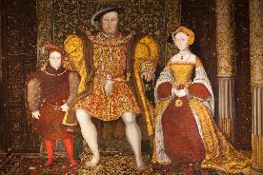

Year 5 Topics
Year 5 – Autumn Term
Tudors
Treason – Berlie Doherty
“Do Everything in Love; we do our best in all we do and all we say with God’s help.”
CD

Slide 14
Curriculum Enrichment in Year 5
Careers Day
Residential trip at Marchants Hill (Monday 28th April – Wednesday 30th April)
The O2 Young Voices concert (Wednesday 22nd January)
Swimming lessons
Forest School sessions
“Do Everything in Love; we do our best in all we do and all we say with God’s help.”
CD

Slide 15
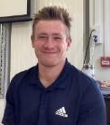
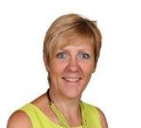
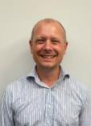
Specialist Teachers
Mr Lelliott – PE Teacher
Madame Shipp – French Teacher
Mr Mott – Music Teacher
Do Everything in Love; we do our best in all we do and all we say with God’s help.”
CC

Slide 16
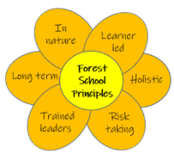
Forest Schools
During the year, your child will experience Forest Schools with Mrs McNie.
Do Everything in Love; we do our best in all we do and all we say with God’s help.”
CC

Slide 17

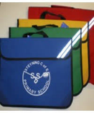
Everyday Routines
Book bags
Reading Diary
Water Bottles
Snack (this is not provided in Years 3, 4 or 5)
“Do Everything in Love; we do our best in all we do and all we say with God’s help.”
TS

Slide 18
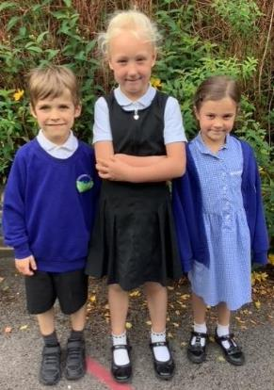
Daily Uniform
Clothing
Black trousers, shorts, skirt or pinafore
White polo shirt or shirt
Royal blue sweatshirt or cardigan (with our without school label)
Blue and white checked dress as a summer option
Plain white or black socks or tights
Shoes
Must wear all black shoes, boots or trainers.
No colour or logos (unless the logo is black)
Shoes must have no heel.
TS
“Do Everything in Love; we do our best in all we do and all we say with God’s help.”
Notes:
RD

Slide 19
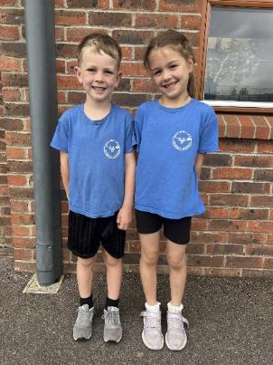
P.E Uniform
P.E Kit
Clothing worn on P.E days must correspond to your child’s team colour
Black shorts or skorts
Plimsolls or trainers
Children should arrive to school in the correct uniform on their P.E days
Jewellery
Simple stud earrings (not dangling or hoops for safety reasons)
No chains or necklaces
A watch may be worn (no internet or phone-based can be worn)
Hair and Make-up:
No make-up or nail varnish
TS
“Do Everything in Love; we do our best in all we do and all we say with God’s help.”
Notes:
RD

Slide 20


How to support your child at home
Learning Times Tables
TT Rockstars
Reading at least 3 times a week, please make sure this is recorded in your child’s reading diary.
Each class will be sending home a weekly overview of that week’s learning for you to support your children at home
“Do Everything in Love; we do our best in all we do and all we say with God’s help.”
CC

Slide 21
Information Booklets online
Include key objectives for reading, writing, maths and spellings for each year group.
Strategies and methods we use to teach addition, subtraction, multiplication and division
Behaviour system
E-safety
Curriculum and timetable details
“Do Everything in Love; we do our best in all we do and all we say with God’s help.”
HR

Slide 22
Inset Days
Monday 2nd September 2024
Tuesday 3rd September 2024
Friday 25th October 2024
Tuesday 22nd July 2025
1 more Inset day TBC
“Do Everything in Love; we do our best in all we do and all we say with God’s help.”
HW

Slide 23


Reading Army
As part of our continued efforts to raise the standards of literacy in school and promote the love of reading, we need your help to grow our Reading Army in 2024-2025.
Here at Steyning Primary we strongly believe in the importance of building a love of reading from a very early age. The teaching of reading starts as soon as the children join us in Reception through high-quality phonics lessons and through the sharing of exciting texts.
By the time the children leave us in Year 6, we would like every child to not only be confident and able readers, but to also have developed a love of reading that will last a lifetime!
Could you help?
Are you able to offer anything from 1 hour a week to a couple of mornings / afternoons a week?
If so, please take an information leaflet and register your interest to join our ever-growing team.
“Do Everything in Love; we do our best in all we do and all we say with God’s help.”
TS

Slide 24
Time to meet your child’s class teacher
You will now have time to visit your child’s classroom and speak to your child’s new class teacher.
“Do Everything in Love; we do our best in all we do and all we say with God’s help.”
CC

