Slide 1

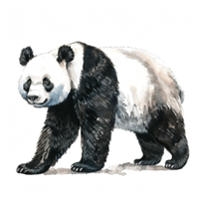
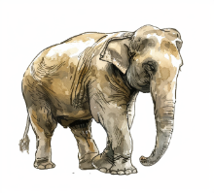
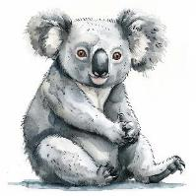


Welcome to the
Year 1 and 2 Induction Meeting
SN
“Do Everything in Love; we do our best in all we do and all we say with God’s help.”
Notes:
SN
Welcome to all familiar parents and carers to Key Stage 1 as well as all those with a child moving into Year 1 for the first time.

Slide 2
Aims of the meeting
Teaching staff for 2024/25
An introduction of Autumn term topics
General information about the year ahead
To answers questions you may have
See your child’s classroom for next year
SN
“Do Everything in Love; we do our best in all we do and all we say with God’s help.”
Notes:
SN

Slide 3
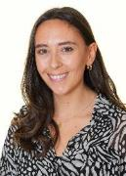
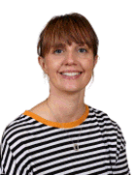
KS1 Teachers and Teaching Assistants
Pandas Class
Sophie Norbury
Carla Duynisveld
SN
“Do Everything in Love; we do our best in all we do and all we say with God’s help.”
Notes:
SN

Slide 4
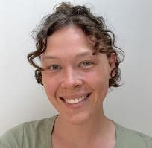
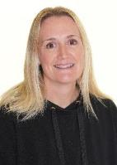
KS1 Teachers and Teaching Assistants
Elephants Class
Jocelyn Harris
Verity Moran
SN
“Do Everything in Love; we do our best in all we do and all we say with God’s help.”
Leisa Hickman
Notes:
SN

Slide 5
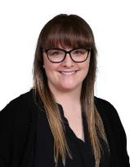
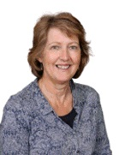
KS1 Teachers and Teaching Assistants
Koalas Class
Beckie Gasson
Pam Willis
SN
“Do Everything in Love; we do our best in all we do and all we say with God’s help.”
Notes:
SN

Slide 6
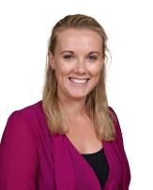
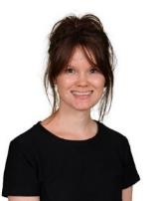
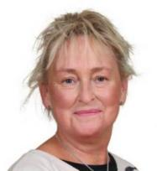
KS1 Teachers and Teaching Assistants
Kangaroos Class
Emily Scozzi & Katy Harrison
Caroline Rose
SN
“Do Everything in Love; we do our best in all we do and all we say with God’s help.”
Leisa Hickman
Notes:
SN

Slide 7



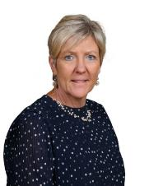
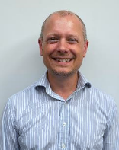
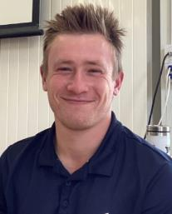
Specialist Teachers
Madame Shipp
Mr Mott
Mr Lelliott
KH
“Do Everything in Love; we do our best in all we do and all we say with God’s help.”
Notes:
KH
All children in KS1 receive a half an hour, weekly French lesson taught by Madame Shipp. These lessons are engaging and fun and progressive through the school.
As well as French, we also have our specialist teachers Mr Lelliot who teaches KS1 classes once a week, and Mr Mott who does the same for Music.
During PE, Mr Lelliot teaches the children core skills such a ball handling, gymnastics, dance and athletics. Within Music, Mr Mott will develop their signing, rhythm and instrument skills. The children love these lessons as they get to explore a range of different instruments.

Slide 8

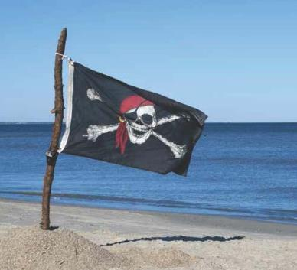
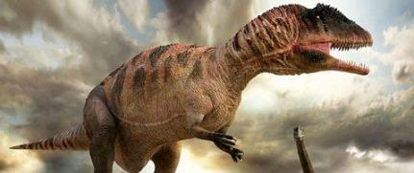
Autumn 1 topics
Dinosaur Planet
Land Ahoy!
JH/ BG
“Do Everything in Love; we do our best in all we do and all we say with God’s help.”
Notes:
JH
In Year 1, our Autumn 1 topic is Dinosaur Planet. This is a history based topic in which the children are taught about different dinosaurs as well as the historical figure Mary Anning. It’s a great hands on topic in which we organise a paleontologist dig and we have a dinosaur visit.
BG
Year 2 will start with Land Ahoy! This is a thls a history based topic where the children will learn about the history of pirates and famous pirates such as Long John Silver and Captain Black Beard! Within this topic, we have an exciting pirate day when the children dress up and become pirates.

Slide 9
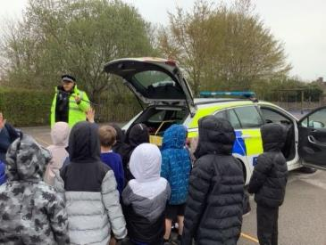
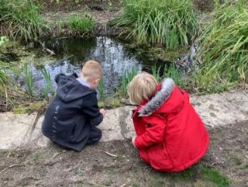
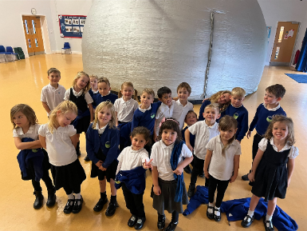
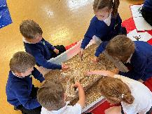
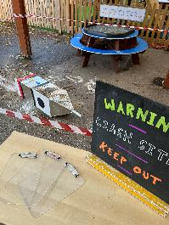
Curriculum Enrichment
BG
“Do Everything in Love; we do our best in all we do and all we say with God’s help.”
Notes:
BG
These are yet to be confirmed but here is a selection of types of trips that have linked to Y1 and Y2 topics in the past. We obviously hope to book a topic related trip or visitors to come in at some point this year when it is deemed appropriate and safe. Such trips out or visitors in enhance the children’s learning and engagement with the topic hugely.
If anyone can help on trips or locality walks messages will go out and we always need you to tell us 3 weeks beforehand due to the risk assessments that we need to fill in and submit.
Not enough helpers compromises the safety of the children, and trips will have to be cancelled.

Slide 10
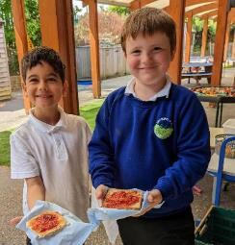
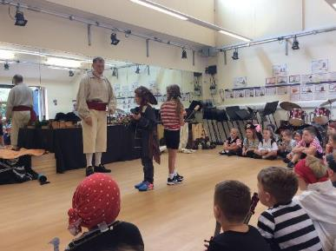
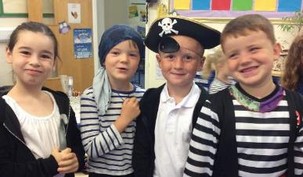
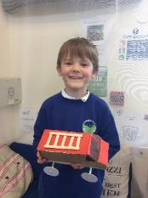
Curriculum Enrichment
BG
“Do Everything in Love; we do our best in all we do and all we say with God’s help.”
Notes:
BG

Slide 11
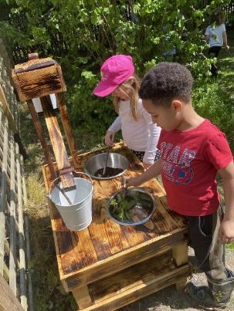
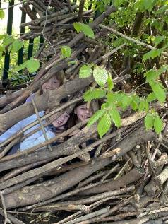
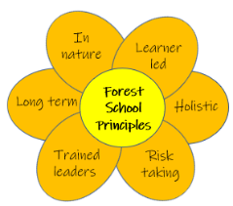
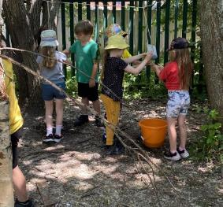
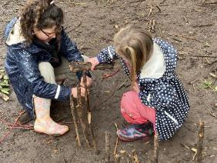
Forest School
JH
Notes:
JH
Each class will receive a half term block of Forest School with our Forest School Facilitator Mrs McNie.
Within these session the children are allowed to explore our wonderful Forest School environment and learn new skills such as whittling, den making, pond dipping and so on.
A letter will be sent out in the coming weeks asking for parent volunteers so if this is something you might want to help with, please look out for the email.
On your child forest school days please provide clothing that you don’t mind getting messy for them to change into or waterproof clothing.
Check the weather forecast to enable the appropriate clothing e.g. wellies and a waterproof coat in the winter months and hats in the summer months.

Slide 12

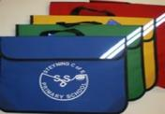


Daily Expectations
Each day, your child will need to bring in:
Water bottle (named)
Yellow reading log and reading book
Optional healthy snack (named pots)
Appropriate P.E kit (on PE days) or uniform
KH
“Do Everything in Love; we do our best in all we do and all we say with God’s help.”
Notes:
KH
Each day, please send in: bookbags, yellow reading logs, water bottles and a healthy snack.
Free snacks are provided in KS1, normally a piece of fruit or vegetable but these are in addition to not instead of what they bring in from home
Please check and recheck labels on all clothes
Year 1 and 2 children will need to come into school dressed in their PE on their PE days. These days will be confirmed in September.
There are 2 short playtimes per day and a lunchtime play everyday

Slide 13
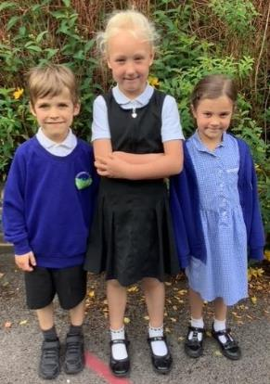
Daily Uniform
Clothing
Black trousers, shorts, skirt or pinafore
White polo shirt or shirt
Royal blue sweatshirt or cardigan (with our without school label)
Blue and white checked dress as a summer option
Plain white or black socks or tights
Shoes
Must wear all black shoes, boots or trainers.
No colour or logos (unless the logo is black)
Shoes must have no heel.
JH
“Do Everything in Love; we do our best in all we do and all we say with God’s help.”
Notes:
JH

Slide 14
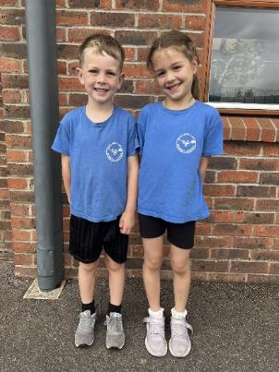
P.E Uniform
P.E Kit
Named clothing worn on P.E days must correspond to your child’s team colour
Black shorts or skorts
Plimsolls or trainers
Children should arrive to school in the correct uniform on their P.E days
Jewellery
Simple stud earrings (not dangling or hoops for safety reasons)
No chains or necklaces
A watch may be worn (no internet or phone-based can be worn)
Hair and Make-up:
No make-up or nail varnish
Year 1
Tuesday
&
Wednesday
Year 2
Monday
&
Wednesday
JH
“Do Everything in Love; we do our best in all we do and all we say with God’s help.”
Notes:
JH

Slide 15
A typical day in KS1
Gates open at 8:40am and register is taken at 8:50am
Daily 30 min phonic lessons
Collective worship
Morning and afternoon breaks
Daily story time
School day ends at 3:15pm
BG
“Do Everything in Love; we do our best in all we do and all we say with God’s help.”
Notes:
BG
Gates will open at 8:40 for registers to be taken at 8:50
Each morning begins with a 30 phonics lesson streamed to their ability and there will be a daily collective worship
Morning and afternoon breaks for all KS1
School day ends at 3:15

Slide 16
Reading
Reading is one of the most crucial skills children learn during their time in primary school. We ask that you find time to regularly read with your child, at least 3 times a week.
This can be done in lots of different ways:
Listening to your child reading aloud to you.
You can read to them (a school reading book, or a book above their phonetic level).
Book talk- discussing what you have read together.
SN
“Do Everything in Love; we do our best in all we do and all we say with God’s help.”
Notes:
SN
Please ensure your comments refers to these questions and are an accurate reflection of what your child has said by writing down the child’s voice – not just ‘read well’.
Book changes happen on Mondays and Fridays. Before children move up a level they need to be able to read with fluency, accuracy and speed as well as comprehend the text. Depending on their progress they may revisit the same book twice.

Slide 17

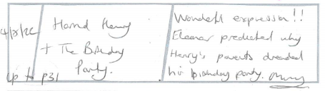
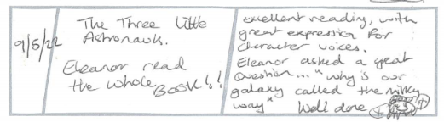
“ This book is by Mini Grey. She also wrote Hermelin!”
“Q: What are burrows?”
“A: burrows are a bit like dens. They are where animals live under ground, like rabbits and badgers.”
“Medusa is the scariest
Mythical creature. Look at her hair!”
SN
“Do Everything in Love; we do our best in all we do and all we say with God’s help.”
Notes:
SN
Here are some high quality examples of comments you could write in the yellow books.

Slide 18
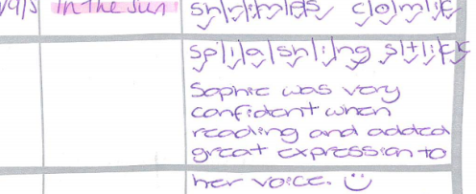
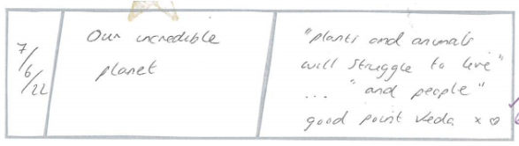
“I think this is a fact book because it is about plants”
“… used Fred talk to sound out t-ee-th”
“I predict that Jarvis will start barking. He looks like a cheeky dog!”
SN
“Do Everything in Love; we do our best in all we do and all we say with God’s help.”
Notes:
SN

Slide 19





Monday
RWI book bag book
Friday
RWI (Fred time) book
SN
“Do Everything in Love; we do our best in all we do and all we say with God’s help.”
Notes:
SN
Book changes happen on Mondays and Fridays.
Before children move up a level they need to be able to read with fluency, accuracy and speed as well as comprehend the text. Depending on their progress they may revisit the same book twice.
Book-a-book: online service run by Mrs Sands that enables parents to book a book at home that then will be delivered to your child to borrow at school.
KS1 will also have the opportunity to have a library session thought the week were they will be able to take a book out on loan. When you know what day your slot is in September please make sure you have put their borrowed book in their bookbag the day before ready for them to take back. If they have 4 books on loan on their account they wont be able to take anymore out until they bring those back. Letters are often given as reminders.

Slide 20
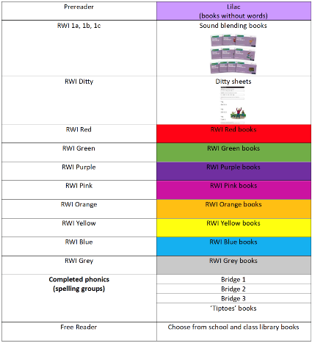
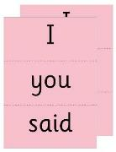
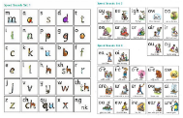
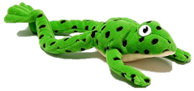
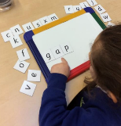
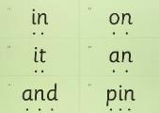
Phonics (Fred Time)
BG
“Do Everything in Love; we do our best in all we do and all we say with God’s help.”
Notes:
BG
At Steyning, we refer to phonics, which is learning the corresponding sounds to letters as ‘FRED time’. Fred time is run every morning and lasts for 30 mins. Within these session children learn a new sound, apply this new sound into spelling as well a book time where they focus on reading one book for that week.
For FRED time, children are streamed from Year 1-2 in Autumn term1 and then Autumn 2 Reception-2. In order to ensure children are in the appropriate levelled group, children are assessed every half term to monitor progress and to make sure the provision is correct.
The Fred group your child is in will be indicated in their yellow reading log each half term by a sticker, this will also show the books they have read..
Once children completed Fred, this is something we aim to happen at the end of Autumn term of Year 2, they will move into a spelling, grammar and punctuation group. These groups are run at the same time as FRED.

Slide 21


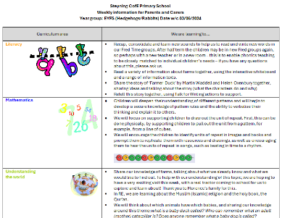

Home Support
BG
“Do Everything in Love; we do our best in all we do and all we say with God’s help.”
Notes:
BG
In order to help your child with their learning at home, we have put made several suggestions within your parent handbooks.
These include: Maths apps, the Letter-join handwriting log in, and ways in which to read with your child. Beginning in September, class teachers will be sending out weekly/ biweekly Parent Overviews which will give you an insight into what your child will be learning in class. It will inform you about maths, literacy, guided reading texts and foundation subjects. There will also be reminders and requests on this overview so please ensure you engage with them. These will be sent by email via the Office, if this arrangement doesn’t work, please speak to your child’s class teacher.
Please spend time looking at these and feel free to speak to your child’s teacher personally if you would like further guidance.

Slide 22
Transitions
EYFS Year 1
Year 1 Year 2
KH
“Do Everything in Love; we do our best in all we do and all we say with God’s help.”
Notes:
KH
Children moving from Reception to Year 1 will continue to engage and learn within the Early Years curriculum where the practise of continuous provision This will be a big focus for most of the Autumn term.
The Y1 team will be planning carefully and will judge when they need to start your child on the Year 1 National Curriculum.
There will be new routines and more distinct subjects to get used to as well as a differently timetabled day that has interactive hands-on learning at the heart of how they learn.
As the year progresses, a more structured learning approach takes shapes which is sensitively conveyed to the children.
KH
Year 2 is similar to Year 1 in many ways. During the Autumn term the Year 2 team will be carefully planning a provision which transitions smoothly on from the end of Year 1.
Some of the differences include:
-Expectation to work more independently.
-In Year 2 there is much more to cover in the curriculum leading up the end of key stage expectations. Because of this it is very important that reading and spelling is at the heart of the routine of home support.

Slide 23
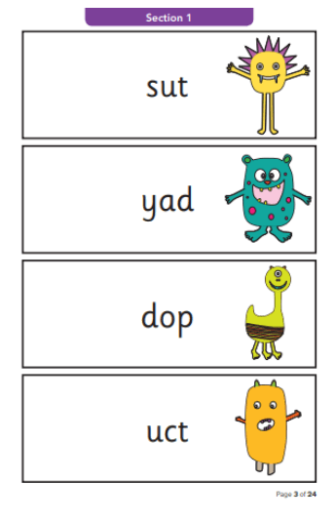
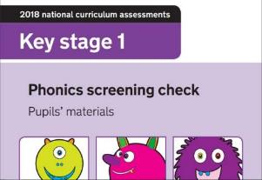
Primary Assessments
Termly assessments
YR 1 Phonics screening June 2024
Year 2 SATs
SN
“Do Everything in Love; we do our best in all we do and all we say with God’s help.”
Notes:
SN
Takes place on a one to one basis
There’s lots of information out there about how best to prepare your child for this (which I would take with a pinch of salt) but to keep it simple I have referenced a link to the government website that tells you what you need to know.
Part of the screening is to ask your child to read words that are not real words. We refer to these as ‘alien words’ or ‘nonsense words’, this is something we practise from EYFS.
There are some additional sounds which will be sent home to support your childs’ learning.

Slide 24

INSET days for 2024/25
Monday 2nd September 2024
Tuesday 3rd September 2024
Friday 25th October 2024
Tuesday 22nd July 2025
One TBC inset day
SN
“Do Everything in Love; we do our best in all we do and all we say with God’s help.”
Notes:
SN

Slide 25


Information Booklets
The teaching team around your child.
Key objectives for reading, writing, maths and spellings for each year group.
Our school behaviour system.
Information on E-safety.
Yearly topic overview.
BG
“Do Everything in Love; we do our best in all we do and all we say with God’s help.”
Notes:
BG
This will be sent home with your child on 14th July

Slide 26

Reading Army
As part of our continued efforts to raise the standards of literacy in school and promote the love of reading, we need your help to grow our Reading Army in 2024-2025!
Here at Steyning Primary we strongly believe in the importance of building a love of reading from a very early age. The teaching of reading starts as soon as the children join us in Reception through high-quality phonics lessons and through the sharing of exciting texts.
By the time the children leave us in Year 6, we would like every child to not only be confident and able readers, but to also have developed a love of reading that will last a lifetime!
Could you help?
Are you able to offer anything from 1 hour a week to a couple of mornings / afternoons a week?
If so, please take an information leaflet and register your interest to join our ever-growing team.
“Do Everything in Love; we do our best in all we do and all we say with God’s help.”
BG
Notes:
BG

Slide 27




Any questions?
You will now have time to visit your child’s classroom and speak to your child’s new class teacher.
SN
“Do Everything in Love; we do our best in all we do and all we say with God’s help.”
Notes:
SN

