Slide 1

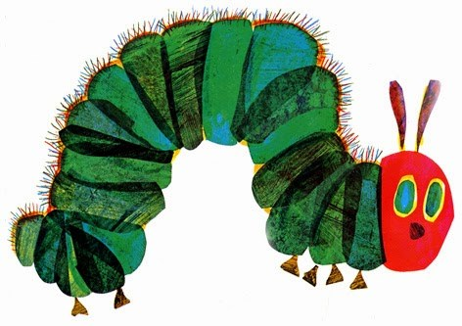

What is Caterpillars and how might it help my child?
At Steyning CE Primary School, we provide non-judgmental pastoral support service for all children and their families. This is provided by our Children’s Mentors, Ellie and Nicole who work in Caterpillars. Caterpillars is a safe place that has a home-like environment where all children are welcomed, valued and empowered in order to overcome barriers to academic, social and emotional learning.
Such Barriers Could Be
• Bullying (including cyber-bulling).
• Low self-esteem / low motivation.
• Social skills.
• Controlling emotions.
• Anything that may cause a child to worry at school.
• Personal organisation.
• Behaviour.
• Relationship difficulties.
• Dealing with bereavement.
• Loss of a loved one.
• Disengagement from learning.
• Attendance and punctuality problems.
• Changes in home life.
Support We Offer
• One to one mentoring sessions tailored to the child's needs.
• Focused group sessions.
• Support at lunchtimes.
• Specific interventions such as Lego Therapy and Circle of Friends
• Liaising with parents / carers and teachers to support pupil progress.
• Supporting children’s transition at all stages throughout their school life.
• Signposting support for families from outside agencies and be the school link where appropriate.
How To Reach Us
We are always happy to help and talk to parents / carers about all aspects of their child’s social and emotional wellbeing, home and school life. You can contact us by calling the school or you can catch us in the playground at the beginning of the school day. Alternatively, please feel free to email us via the school office;
office@steyningprimary.org.uk

