Slide 1

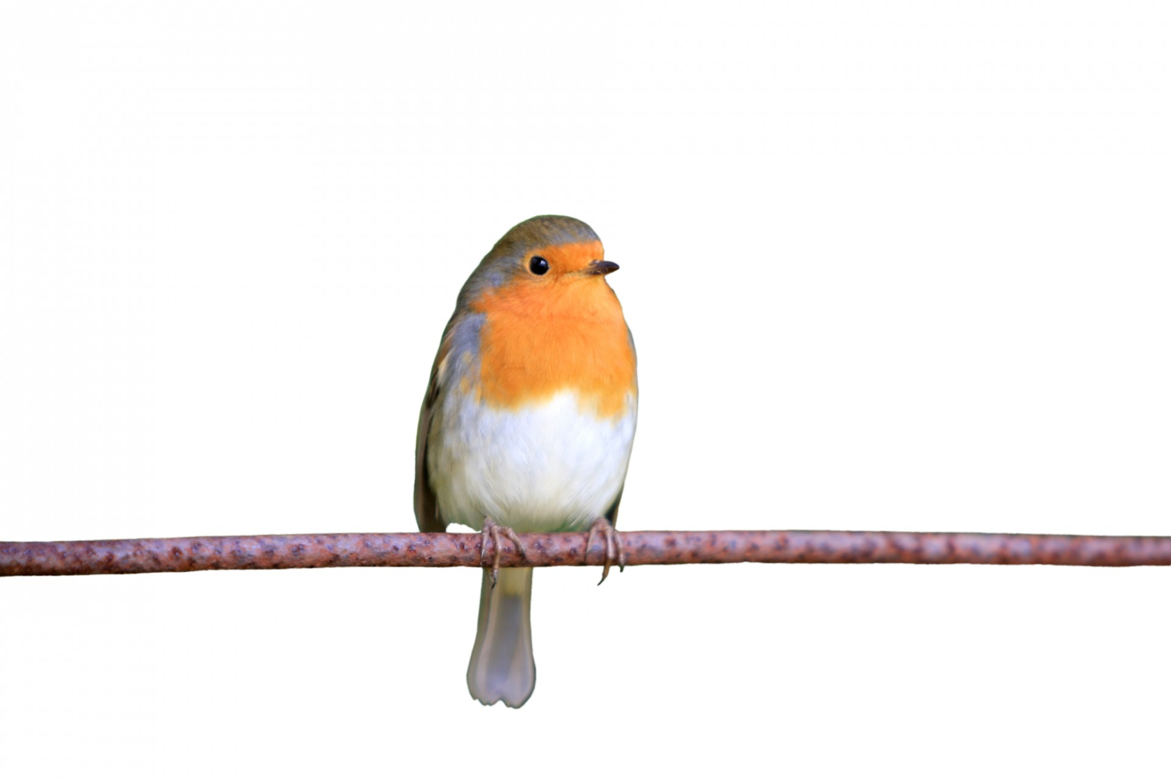
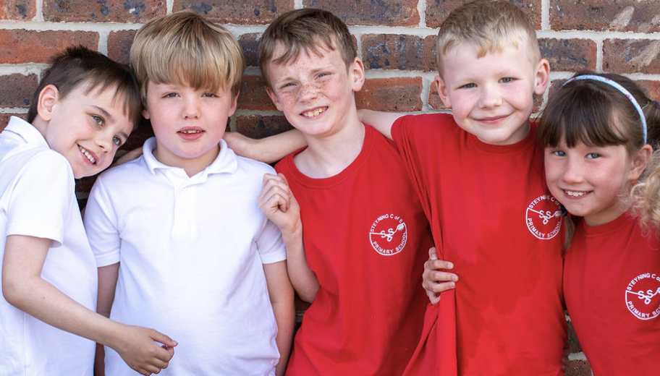

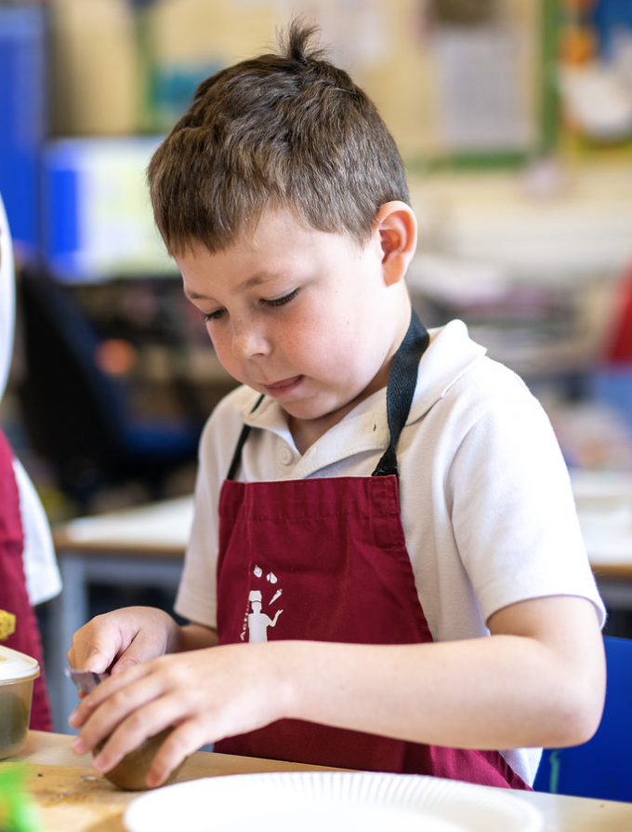
What is the SSC and who can access this support?
Steyning CE Primary School has a Special Support Centre (SSC), for children with severe and specific speech and language disorders attached to our mainstream school.
Our Special Support Centre is known as Robins Class.
We have 10 places in the SSC and the children range from Reception to Year 6.
Our SSC provides individually targeted support from a specialist Speech and Language Therapist, a specialist teacher experienced in speech and language impairment and specialist support staff who all work together in a collaborative team. Children are integrated into mainstream class as far as is possible and supported there by SSC staff where necessary as well as withdrawn to Robins for specific interventions and speech and language therapy sessions. Children in the SSC must have an Education Health Care Plan (EHCP) with speech and language as their primary need with a discrepancy between verbal/language skills and non- verbal skills.
Children may have;
Receptive language disorder
Expressive language disorder
Speech Sound disorder
Phonological difficulties

